Slide 1
Foundations in Government and it’s Origins
What is Government

Slide 2
Vocabulary for Unit One
1.Establish
2. Levy
3. Vital
4. Limited Government
5. Representative Government
6. Charter
7. Anarchy
8. Government
9. Nation State
10. Country
11. Sovereignty
12. Divine Right
13. Social Contract
14. Philosopher
15. Theory

Slide 3
Foundations of Gov.
A state without government and laws is Anarchy
The Government has five key purposes
Providing Leadership
Maintaining Order
Providing Public Services
Providing National Security
Providing Economic Security and Economic Assistance
The last one is up for debate, so lets debate!

Slide 4
Foundations of Gov.
Four theories on why governments were established
Evolution Theory – Started with heads of ancient families, clan traditions, etc.. Believed that government came out because extended families needed more organization.
Force Theory – States emerged when people needed cooperation to survive. So one or more people took control, usually by force or threat of violence.
Divine Right Theory – Certain people were chosen by God or gods. Also believed that they were decedents from gods.
Social Contract Theory – Some people believed that states exist to protect and to serve their people. Without state or government, people would live in a “state of nature” where life would be short, brutish, and nasty.
Another version is that people surrendered their freedom for safety
Which one do you think?

Slide 5
Foundations of Gov.
Take notes on this video it best describes All of this.
https://www.youtube.com/watch?v=jJEuZrvNYg0

Slide 6
Foundations of Gov.
Principles of Government – These are all key
Citizen Participation – Must be informed!
Regular Free and Fair Elections – they need to be legit
Accepting the Results of Elections – Give them around 200 days
The Rule of Law – No one is above the rule of law? Really?
Majority Rule with Minority Rights – This has been lost in today’s world
Accountability – Don’t blame the last president when you are 5 years in
Transparency – “If they want to know what’s in the law they have to pass it first.” – Nancy Pelosi on Obamacare.
Limited Government and a Bill of Rights – So why are they invading our bedrooms, bathrooms, dinner tables, schools…..should I keep going?

Slide 7
Foundations of Gov.
Control the Abuse of Power – Done through limited powers
Economic Freedom – Why do some jobs in the rust belt make it mandatory to join a union? How does it fit here?
Equality – Self explanatory
Individual Human Rights – First 3 Amendments basically
Independent Judiciary – Public opinion does not supersede facts
Competing Political Parties – Two or more
As you can see we don’t oblige to some of these anymore is that a good thing or a bad thing?

Slide 8
Foundations of Gov.
Fundamentals of Economics – What’s in your Country?
These factors of production are a must in any economy
Producers – People who make goods and services
Distributors – Those who get the products to buyers
Consumers – the customer
Labor – Those who make it
Resources – Natural resources such as land and water
Capital – The money
Entrepreneurs – Risk taking individuals who combine the other factors of production to make money.
Three key questions one needs to ask with Economic Systems
1. What and how much should be produced?
2. How should goods and services be produced?
3. Who gets the goods and services that are produced?

Slide 9
Foundations of Gov.
Capitalism – Economic system that emphasizes private ownership of factors of production, freedom of choice, and individual incentives
Applies to Workers, investors, and business owners
The Goal is what?
To create a free market - no limits on the freedom of buyers and sellers to make economic decisions
Origins comes from Laissez-Faire meaning let alone.
Free Enterprise – This is the form of Capitalism we have here in the U.S.
Some government regulations are in place and necessary .
Deeply rooted in individual initiative
Each person knows what is best for themselves while also respecting the rights of those to own property, this includes the freedom to make economic choices.

Slide 10
Foundations of the Gov.
Mixed Economies – Combination of Capitalism and Socialism
Some Economists think the U.S. is this for these reasons:
As federal governments grow they buy more goods, and services
More and more regulations to industries – Some are important and others are totally insane
Temporary government programs during the depression that were then magically entrenched in our society. Private or Government Construction companies, which do you prefer?

Slide 11
Foundations of Gov.
Socialism – Government controls almost everything from wages to distribution of who gets those goods.
Why does Socialism always fail? Four factors
1. Little to no knowledge of the industry
2. Unreasonable regulations and demands on every industry
3. Kills innovation totally
4. Runs out of the money
Places it has failed
Italy
Germany
France
Norway
France Again
Poland
Switzerland
Belgium
India
Shall I go on?

Slide 12
Foundations of Gov.
Democratic Socialism – Redistribution of wealth
Why it also has failed everywhere it has been implemented
1. Perpetuates laziness – If I don’t have to work for it, then why work
2. Kills innovation
3. Creates class warfare on a massive scale
4. Increases dependencies
5. Runs out of Money
6. Gives the government more power than was intended
7. Creates unstable communities
8. Little to no knowledge of the industry
9. etc.
Places it Failed
France
Greece
Detroit , MI
LA, California
Brooklyn, New York
Cuyahoga , Ohio
Again Shall I go on?

Slide 13
Foundations of Gov.
Communism – Total government control.
Controls the Following
What to Produce
How to Produce
What to distribute
How to Distribute
What goods and services are produced
Why does it fail
1. Little to no knowledge of the industry
2. Unreasonable regulations and demands on every industry
3. Kills innovation totally
4. Runs out of the money
Where has it been implemented
Russia
China
All over the Middle East
Italy
Many of the countries in the old Austria Hungry Region

Slide 14
Foundations of Gov.
Checks and Balances – This system allows for the power to be limited by other branches of the government.
Political Parties – A group organized around a common interest and goals, they then compete against each other in elections.
Constitution – Establishes the basic structure of government and rights of the people. It acts as the Supreme law of the land.

Slide 15
Foundations of Gov.
Confederacy – A union of sovereign states with a weak central power; the U.S. would eventually move on to a federal system with a strong central government
Rule of Law – Consistent enforcement of laws; anyone who breaks the laws are held accountable.
This does not mean the court of public appeal decides the outcome once an arrest is made.
The process as a whole for rule of law looks like this:

Slide 16
Foundations of Gov.

Slide 17
Foundations of Gov.
Democracy – With a democracy you will find the following:
Constitution – Set of Laws as we already explained
Political Parties – Can be two or more
Representatives who make laws
A key to remember what gives us all of our freedoms, from speech to trial is our Bill of Rights
The reason we are a republic and not a democracy is that there is suppose to be a proper limitation of government power

Slide 18
Foundations of Gov.
Can one change the Constitution?
Yes Correct. How does one change the Constitution?
Through a process called Amendments
What of the two party system?
Since 1932, they have won 12 of the 21 election cycles. An okay split.
Some people are concerned however, because when multiple parties run, but the same party always wins, you have the makings of an Oligarchy
Take a look at this:

Slide 19
Foundations of Gov.
2000
2012

Slide 20
Foundations of Gov.
Economics
So what if we take more from the rich and give to the lower classes, what would happen?
If a democracy becomes an Oligarchy this always happens
Rich get richer, at the expense of others. How?
Through price gouging or worse.

Slide 21
Origins and Government in Colonial time
A Deeper look
At
American Government

Slide 22
Origins – Where it all comes from
U.S. Culture what is it?
This country was founded on Judeo-Christian values, and ideas
These principles made an important contribution to the founding documents and culture of the United States
Our Culture is unique it consists of the following
Working with all types of races, religions, and wealth status
Baseball
Bar B Q – Hot Dogs, and Apple Pies
Family dinner – sit down and eat as a family. Dinner is the biggest meal
Hard working – We are one of four major countries that have a five days a week 40 hour work week.
Rock and Roll
Modern Christmas celebration - Was originally for the upper-class U.S. by the mid 1800’s changed the concept

Slide 23
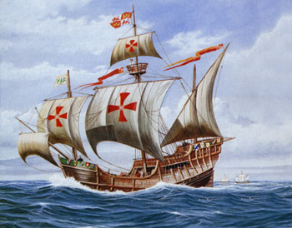
Origins – Where it all comes from
The building blocks of our government stems from two key concepts:
Limited Government – Concept of governments power is not absolute. Think of it this way:
Government does not have the authority to tell you what foods you can eat, how much you can spend, or how live your daily life.
Representative Government – A system of government where people elect delegates to make laws and conduct the government
By the 1200’s this concept really took off. The Magna Carta was signed by the King by force of the British Nobles.
No not that Santa Maria, the Magna Carta

Slide 24
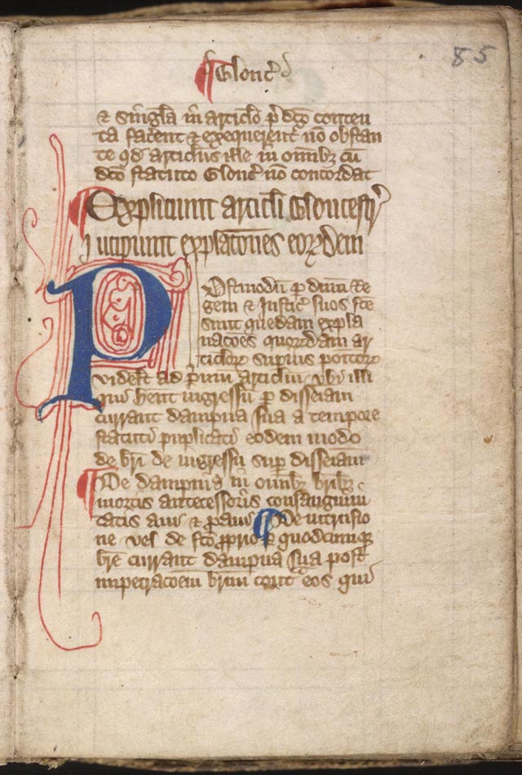
Origins – Where it all comes from
Yes that’s it! ……….>
The English Bill of Rights – 1688
The British still had issues so they pushed
the King out and established Parliament.
1689 Parliament passed the English Bill
Of rights. It stated
Monarchs do not have complete authority
Monarchs must have parliamentary support
to raise taxes
The people have the right to petition the
government and have the right to a fair and
speedy trial
People should not be subject to cruel and unusual punishment or excessive fines or bails.
Sound familiar?
It should some of our constitutional rights are in there.

Slide 25
Origins – Where it all comes from
English Law – had major influences on the colonies.
New Political Ideas – The Social Contract, and Natural Rights
Colonial Governments
Each of the 13 colonies had their own government, their own court system, and their own legislature (elected at least in part)
Written Constitutions
Mayflower Compact – allowed for self-government
Charter – Gave people of Connecticut the right to elect guvnors, judges, and representatives.
Known as the first American Constitution. Soon after other colonies wrote their own charters
Colonial Legislatures – mostly appointed by the king, and in some area’s the king even appointed church leaders
By the mid 1700’s legislative bodies were dominant in political life, and by 1776 was entrenched in colonial life.

Slide 26
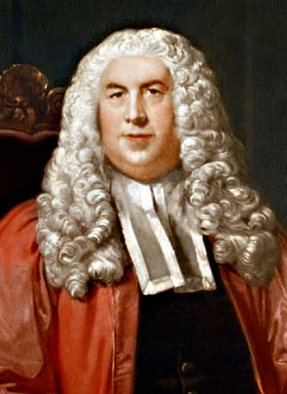
Origins – Where it all comes from
People who influenced the American Government
Sir William Blackstone
Believed in the law of Nature a concept
found government worship repulsive
The law of Nature, as found in the Bible,
is perfect and supreme no human law
should be made to contradict it.
Essentially what is he saying here?

Slide 27
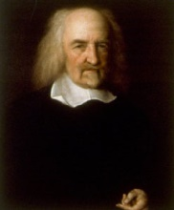
Origins -Where it all comes from
Thomas Hobbs
Believed a forceful government was
necessary to maintain control.
Did not have a high opinion of people as a
whole.
The natural state of man is war. People live
in fear of one another, which is why man
is willing to trade individual liberty
for the security of living in a society under
a government
Do you agree?

Slide 28
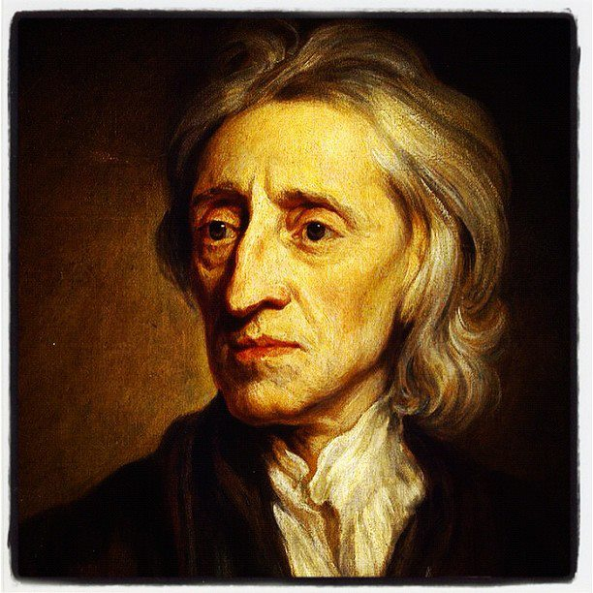
Origins – Where it all comes from
John Locke
Believed Men are born equal
and with rights that can’t be denied
Had a belief that people had a right
to live freely and wanted to live with
as little government interaction as
possible.
Men are born equal and given rights
that cannot be denied. No man may
be taken from his property, his life
forfeit, and subjected to the
authority of a government without
his consent
What is he saying here?

Slide 29
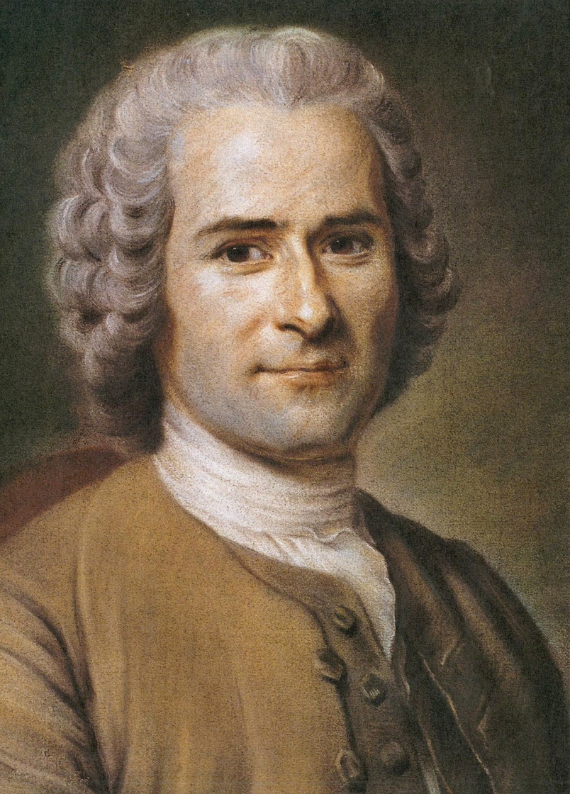
Origins – Where it all comes from
Jean-Jacques Rousseau
Had a belief that people are naturally good
people in general just want to be left alone
and if so would work together for the
common good.
Believed that property rights and other basic
rights such as freedom of speech and religion
came from people living together in a
community.
By working cooperatively, people created a
social contract that allowed them to preserve
their rights while at the same time creating
law and government.
How do you feel about people in general?

Slide 30
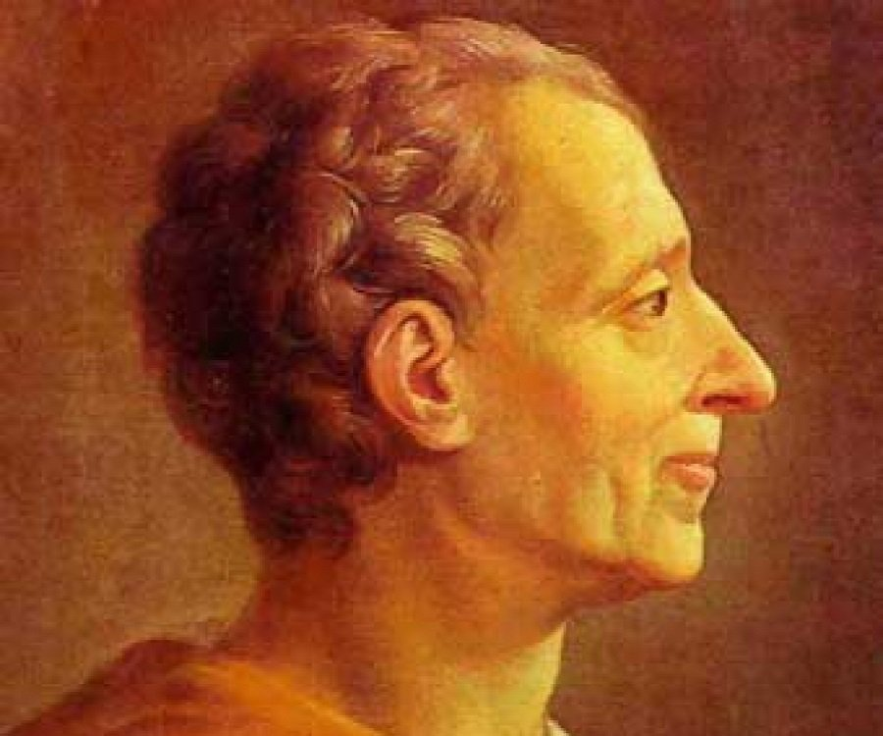
Origins - where it all comes from
Charles – Louis de Montesquieu (Emperor Palpatine)
A French writer who wrote about the
importance of separation of powers
“There can be no liberty where the
legislative and executive powers
are united under the same person….
[or] if the power of judging be not
separated from the legislative and
executive powers.
Has there ever been a time in this
country where one party has had all
three branches of government?

