Slide 1
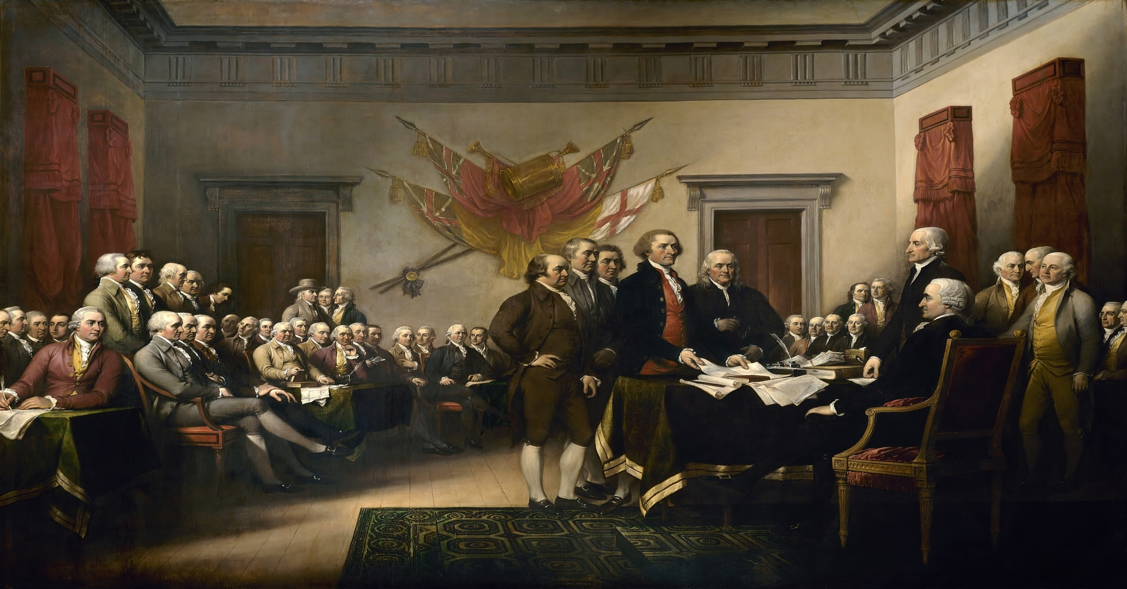
Uniting For Independence
Unit Two

Slide 2
Uniting For Independence
Vocabulary
1. Draft
2. Consent
3. Revenue
4. Embargo
5. Boycott
6. Human Rights
7. Taxation without Representation
8. First Continental Congress
9. Second Continental Congress
10. Declaration of Independence

Slide 3
Uniting For Independence
The issues that arose
Early on the Colonies were left alone, word from the Monarch traveled slowly and by the nature of being 3,000 miles away the Governors and Legislature got used to governing themselves.
British tighten control – As the Brits did this more and more of the Colonials became resentful. Two events changed everything
The French and Indian Wars – The Indians who sided with George Washington who was the general of the British Army. The British won the war in 1756 effectively ending French power in North America
Wars cost money and this one was no different the British piled up huge debt. The British to stop the Indian Rebellions left a standing army in the Colonies.
1760 King George III became king
The outrageous taxes began. Taxes on tea, sugar, glass, paper, and other products caused unrest in the Colonies.
The Stamp Act 1765 – First direct tax on Colonist alone not levied on the homeland British
Taxed them on legal documents, pamphlets, newspapers, even dice, and playing cards.
British Parliament also passed laws regulating colonial trade in ways that benefited Great Britain, but not the colonies.

Slide 4
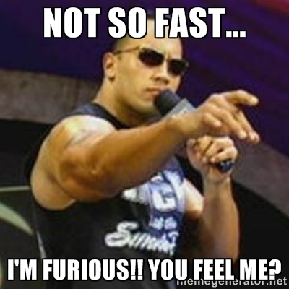
Uniting For Independence
More issues
The resentment grew in the colonies, so they boycotted British goods, and refused to buy them. The protests led to the repeal of the Stamp Act – Victory!!

Slide 5
Uniting For Independence
Nope it got worse, yup it definitely got worse

Slide 6
Uniting For Independence
March 5th, 1770 Boston Massacre where Patriot mobs threw snowballs, sticks, and rocks were fired upon by the British Army
British replaced it with a far worse tax plan called the Townshend Act
Escalated by 1773 and led to the Boston tea Party.
Colonist dressed up as Mohawk Indians and dumped 342 chests of tea into the Boston Harbor
Britain retaliates with the Coercive Acts
Also known as the intolerable acts
Two of the most notable things from the Intolerable Acts were:
1. Closing of the Boston Harbor
2. Massachusetts could no longer govern themselves
3. Finally the forced quartering of British Soldiers – They were to be fed taken care of and if they needed a companion for the night either daughter or Wife must comply.
Colonies unite
Nothing brings people together like a common enemy. The colonist started uniting under these repressive acts and started calling themselves Americans
Taking Action
1765 nine colonies sent delegates to protest the Stamp Act and King George’s Actions
1773 Colonist opposed British rules forming organizations to keep in touch and keep the resistance going.

Slide 7
Uniting For Independence
Eventually these groups called committees of correspondence, sprung up quickly. A few months after Sam Adams formed the first prominent people like Thomas Jefferson, and Patrick Henry started really bringing validity to the group.
September 5th, 1774 Every colony except Georgia met in Philadelphia for the first Continental Congress.
If Britain knew they were meeting it would have been a death sentence.
George Washington, Richard Henry Lee, Sam Adams, and Patrick Henry to name a few were there. They ultimately decided on the following:
Embargo on all British goods
Boycott of all British goods
A second meeting took place, and was largely uneventful. They left the policies in place
King George III response
“New England Governments are in a state of rebellion. Blows must decide whether they are to be subject to this country, or independent.”
April 19th, 1775 Redcoats clashed with Minutemen at Lexington and Concord in Massachusetts. This became the first battle of the Revolutionary War.

Slide 8
Uniting For Independence
Second Continental Congress – All 13 colonies meet in Philadelphia
Immediately assumed the role of a central government and made John Hancock of Massachusetts President
Also assumed and Army, and Navy and funds to run it.
They Appointed George Washington as the Commander of the Continental Army
It was the acting government for the war, it negotiated treaties, and rallied support for the colonist cause.
Declaring Independence – Yes the issue was still in debate on declaring their independence.

Slide 9
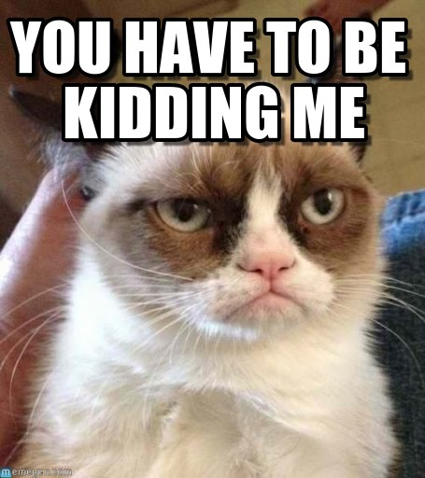

Slide 10
Uniting For Independence
Thomas Paine
“The Powers of government still remaining in the hands of the [king],…And as he hath shown himself such an inveterate enemy to liberty, and discovered such a thirst for arbitrary power, is he, or is he not, a proper man to say to these colonies, ‘You shall make no laws but what I please!’”
What is Thomas Paine saying here?
Sam Adams Letter April 3rd, 1776
“Is not America already independent? Why then not declare it?... Can Nations at war be said to be dependent either upon the other?...Upon what Terms will Britain be reconciled with America?...[S]he will be reconciled upon our abjectly submitting to Tyranny, and asking and receiving Pardon for resisting it. Will this redound to Honor or the Safety of America? Surely no.”
What is Sam Adams saying here?

Slide 11
Uniting For Independence
Poor John Adams
John lost his mind trying to convince the congress to split from England and declare it’s independence.
No one liked him. Except for a small few. Ben Franklin, Richard Henry Lee, Thomas Jefferson, and John Hancock made up the only part of Congress that liked him
John was a brutally honest, upfront sort of character. He told you what he thought of you whether you wanted to know or not, whether it was good or not.
“I have seen many a worthless slug in my time, and made the company of some of the most vile people God put on this earth, and after spending five minutes with you sir, I prefer the company of slugs, and the vile.” – A statement made to a fellow Congressmen
Because of this Ben Franklin knew he needed to find a better spokesmen for independence
June 1776, after nearly two years of trying Richard Henry Lee of Virginia introduced a resolution to Independence – Finally it was agreed to be heard
July 2nd 1776 it passed and a committee was assigned to draft a proposal
Thomas Jefferson, Robert Livingston, Rodger Sherman, and yes Ben Franklin, and John Adams were on it.

Slide 12
Uniting For Independence
Thomas Jefferson a skilled writer was asked to write it
After several omissions – which recently have come under fire unfairly because of Political Correctness and revisionary history, the movie will explain the reason for the omission clearly and concisely.
All 56 of the 57 delegates signed it. The key here is all 13 colonies did sign it but only one of the delegates refused to show up that day.
John Dickinson – A real American hero?
John fought the Declaration every step of the way, and led the coalition to stay as a part of England. He held this position the entire time.
He is the only person to have been present to the Declaration of independence, Articles of Confederation, and the Constitution and not sign a single one.
Every signee knew they were the first to the gallows if they lost the revolution, they put their names out there for Britain to see. The heroism of this cannot be understated.

Slide 13
Uniting For Independence
Declaration of Independence – First time in world history a country was started on the principles of human liberty and consent of the governed. It consists of four parts:
1. Preamble – Describes these basic rights America enjoys today
2. Human Rights – Was a shot at the South and it’s slave policies. This singular phrase as well as the Great Compromise, and the three-fifth compromise in the Constitution would allow the issue to be revisited in the future and led to the end of slavery.
“We hold these truths to be self-evident, that all men are created equal, that they are endowed by their Creator with certain unalienable Rights, that among these are Life, Liberty, and the pursuit of Happiness. That to secure these rights, Governments are instituted among Men, deriving their just powers from the consent of the governed, That whenever any Form of Government becomes destructive of these ends, it is the Right of the People to alter or abolish it.”
Lets discuss this shall we?

Slide 14
Uniting For Independence
3. Specific complaints or grievances against George III.
4. The conclusion – States the colonists’ determination to separate from Great Britain.
This was a final effort to split peacefully.
The First States and the First State Constitutions
At this point every state viewed themselves as Free and Sovereign. The wrote their own constitutions being sure to include a bill of rights and a limited government.
The interesting thing yet is they were basically 13 different countries with different laws and currency. They were not yet the United States of America.

