Slide 1
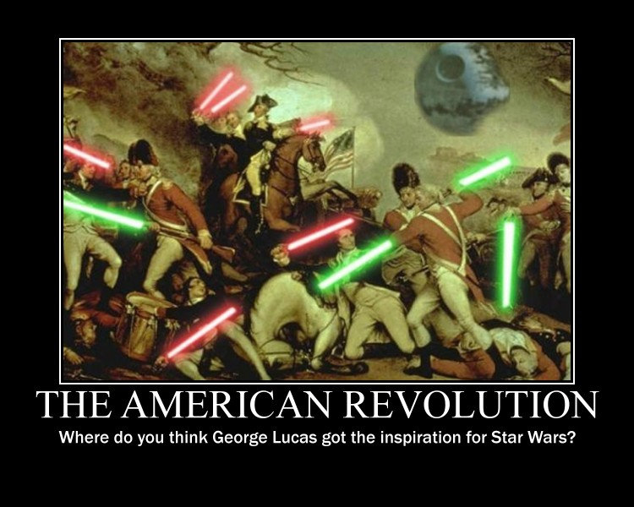
The American Revolution
Unit 2 week 2

Slide 2
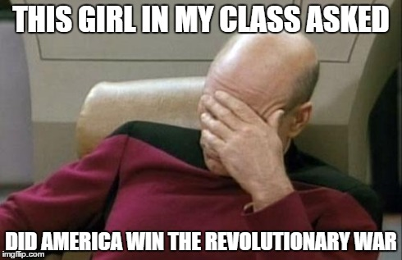
Setting it Up
American Revolution

Slide 3
American Revolution – Setting it up
Molasses Act – March 6th, 1733 – Taxed at 6 pence (percent) on any molasses entering the Colonies
Currency Act – 1751 – Prohibited any new currency, or credit to the colonies
Sugar Act –April 5th, 1764 – Forced collection of the Molasses tax from 1733 plus interest.
Stamp Act - March 22nd, 1765 - First direct tax on Colonist alone not levied on the homeland British
Quartering Act – 1765 – Once Barracks were full Inn’s and houses had to quarter soldiers

Slide 4
American Revolution – Setting it up
Declaratory Act – March 18th, 1766 – repealed the Stamp Act and lessened the Sugar Acts collection
Townshend Act – July 2nd 1767 – Taxes on glass, lead, paper and paint
Boston Massacre – March 5th, 1770 – angered by the presence of troops the public throws a snowball soldier is knocked down fires his musket into the crowd, as do the other soldiers killing five
Repeal of the Townshend Act – April 12th, 1770

Slide 5
American Revolution – Setting it up
Burning of the Gaspe – June 10th, 1772 – Locals angered by the trade laws that crippled the Colonial economy in Rhode Island sank and burned the revenue collectors ship while it was at port.
Tea Act – May 10th, 1773 – A tea tax that was directed only on the America’s on any tea they purchased, done to give money directly to the East India Company, which at this point was floundering. American’s saw it has indirect tax subsidizing a British Company. They were right.
Publication of Thomas Hutchinson’s letters – July 1773 – Letters warning the colonials of the British attempt to clamp-down on their freedoms.

Slide 6
American Revolution – Setting it up
The Boston Tea Party – December 16th, 1773 - Colonist dressed up as Mohawk Indians and dumped 342 chests of tea into the Boston Harbor
The Intolerable Acts – May to June 1774 – Four Measures that stripped Massachusetts of self-government and judicial independence. Colonists boycott all British goods.
First Continental Congress – September 1774 – Delegates meet to organize opposition to the Intolerable Acts

Slide 7
American Revolution – Setting it up
Battles of Lexington and Concord – April 19th, 1775
Paul revere ran through the streets screaming the British are coming.
The Militia within minutes got their gear, and got into position to stop the British attempt to massacre hundreds of Americans the woman, children, and the men. (Hence the name Minutemen)
The idea was to crush the resistance right where it stood, and show the American Army was undisciplined, unskilled, and incapable of beating the British Army.
The Americans slaughtered the British in both Lexington, and Concord and proved to the British they were not just a bunch of ignorant untrained people with guns.
The shot heard round the world!

Slide 9
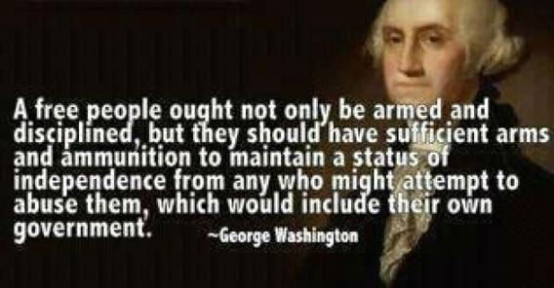

Slide 10
“When any nation mistrusts its citizens with guns it is sending a clear message. It no longer trusts its citizens because such a government has evil plans.”

Slide 11
How it unfolded
American Revolution

Slide 12
American Revolution – How it unfolded
Second Continental Congress June 16th, 1775 – Continental Congress appoints George Washington Commander-in-Chief of Continental Army; issued 2 Million bills of credit to fund the army.

Slide 13
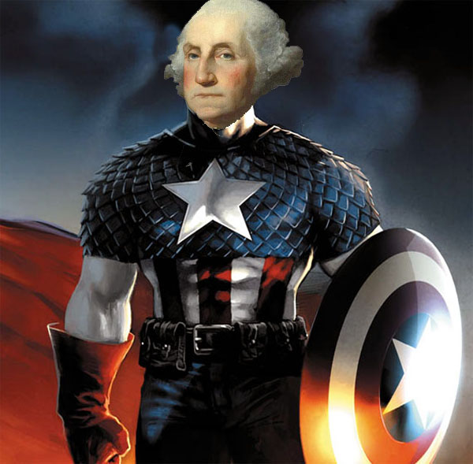

Slide 14
American Revolution – How it unfolded
Battle of Bunker Hill June 17th, 1775 – The first major battle of the War of Independence. Sir William Howe dislodged William Prescott’s forces overlooking Boston at a cost of 1054 British casualties to the American’s 367.
Olive Branch Petition – July 5th, 1775 – Congress endorses a proposal asking for American rights, the ending of the Intolerable Acts in exchange for cease fire. John Adams demands independence yet again, but is denied. A vote of 10-3 passes the Olive Branch petition. John Adams goes to England. John Adams after delivering it and hearing the refusal said “For you know not what you have done.” King George III Declares Colonies is open rebellion.

Slide 15
American Revolution – how it unfolded
Thomas Paine’s Common Sense published anonymously in Philadelphia – January 9th, 1776 – John Adams presents it and again demands Independence, again it, does not even reach the floor for a vote.
France Provides Covert aid to the Americans – May 2nd, 1776.
Second Continental Congress issues Declaration of Independence – July 4th, 1776

Slide 16
American Revolution – How it unfolded
Battles of Long Island and White Planes – August – December 1776 – British forces occupy New York, after American Defeats.
Battle of Trenton, New Jersey – December 26th, 1776 – American victory boasts American Morale. Outnumber a great tactical victory for Washington. He used the forest, and a split system attack.
Battle of Princeton, New Jersey – January 2-3 1777 – General Washington broke camp at Trenton to avoid a British advance, attacking the British rearguard and train near Princeton and then withdrew to Morristown.

Slide 17
American Revolution – How it unfolded
British Surrender of 5,700 troops at Saratoga – October 13th, 1777 – Lacking supplies British, German, and Loyalist forces under Major General John Burgoyne surrender to Major General Horatio Gates. Considered a major turning point in the Revolutionary War.
Articles of Confederation – November, 1777 – The first constitution of the U.S. made the America’s a confederation of States with its own separate governments, laws, and currencies. No Central Government.
France becomes first major country to recognize U.S. Independence- February 6th, 1778

Slide 18
American Revolution – How it unfolded
U.S. Defeat at battle of Camden – August 16th, 1780 – The end of Major General Horatio Gates field command. He is routed soundly at Camden SC. He was careless with the men he had and did not wait for French support, the strategy was costly. Lost 162 men and gave the British a stronghold in the south. The British had already won Charleston, so this was damaging to the Southern front.
Ratification of the Articles of Confederation – March 1st, 1781 – Not much changed just a few ambiguous details were now specified. The most dramatic improvement is this: “Each state retains its sovereignty, freedom, and independence, and every power, jurisdiction, and right, which is not by this Confederation expressly delegated to the United States, in Congress assembled.”

Slide 19
American Revolution – How it unfolded
Battle of Capes September 5th, 1781 – Denied British reinforcements or the ability to evacuate.
Surrender of British forces under Cornwallis at Yorktown – October 18th, 1781.
British authorizes peace negotiations – March 5th, 1782.
Treaty of Paris – September 3rd, 1783 – Formally ended the Revolutionary War.

Slide 20
A look at our First President
George Washington

Slide 21
George Washington
Is credited for saving the U.S. twice.
1. The Revolutionary War – Duh
2. At one point all the money promised to the soldiers was revoked because the government had no money. The soldiers were ready to storm Philadelphia and overthrow the government. George Washington said “You saved this nation once with your sacrifice, and courage I ask you to do it one more time. “
They listened and never revolted.

Slide 22
George Washington
Only said two things at the Constitutional Convention.
The second was the most profound – When discussing how many men the Army should have, it was suggested that only 10,000 should be the max. Washington replied “Perhaps the enemy should be told to invade with no more than 10,000 men then.” This immediately changed and the number of max soldiers was never placed in the Constitution.
Was nominated president with 100% of the electoral vote in his first “Election” in 1789.
Only President in U.S. history to win 100% of the Electoral vote. Poor John Adams, twice lol.

Slide 23
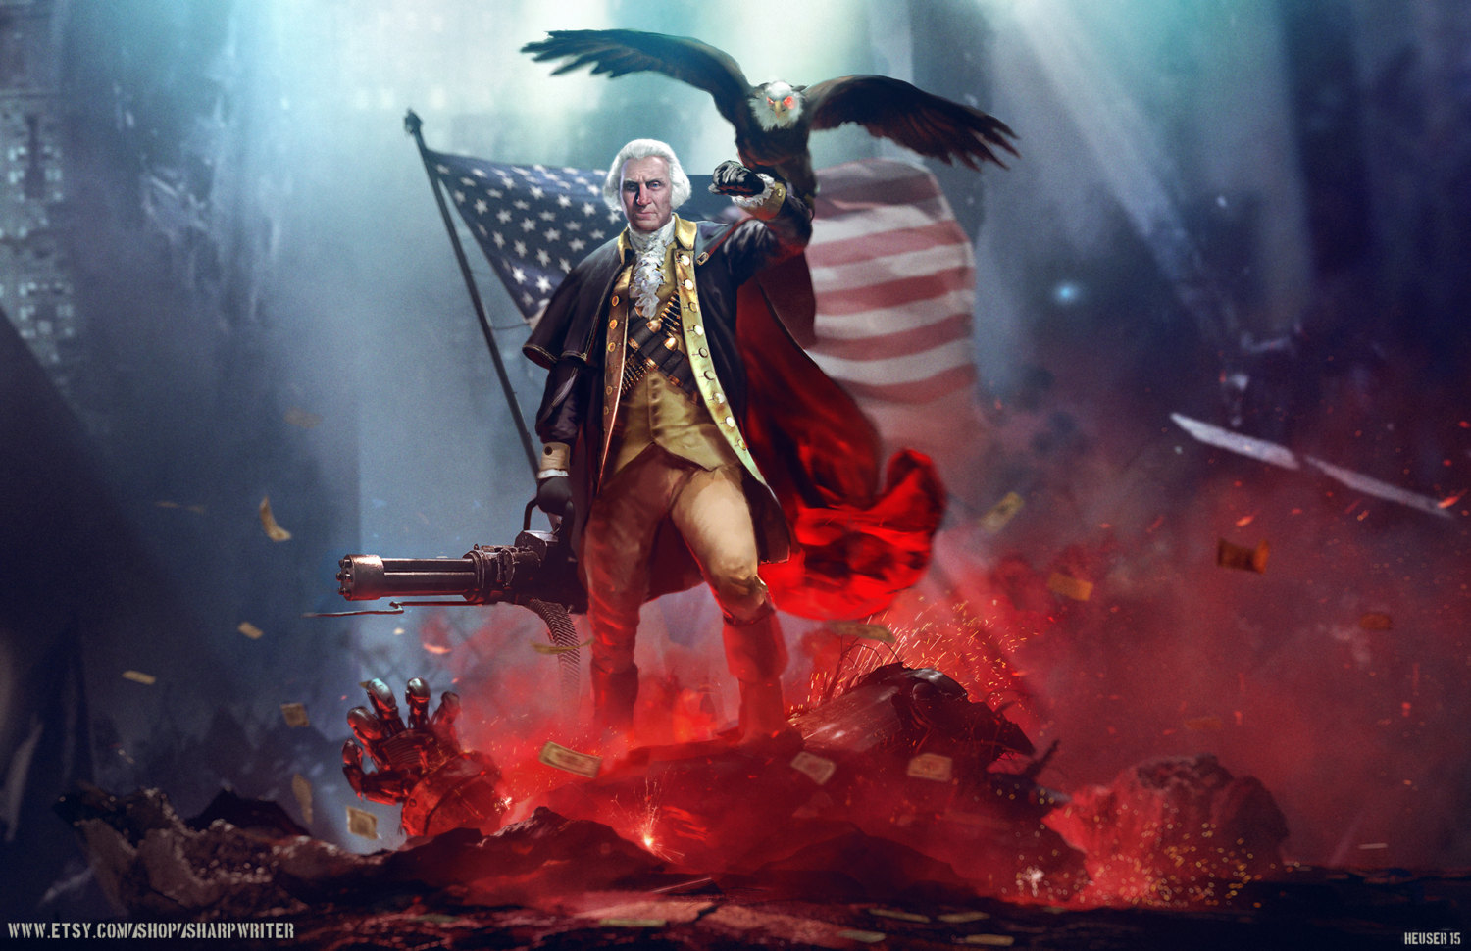
George Washington

Slide 24
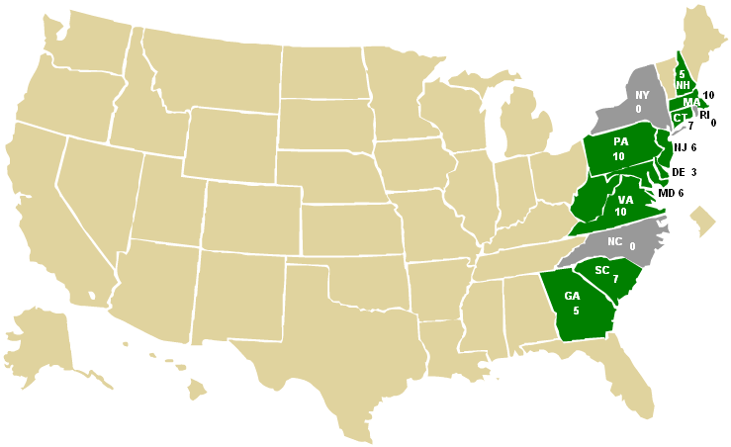
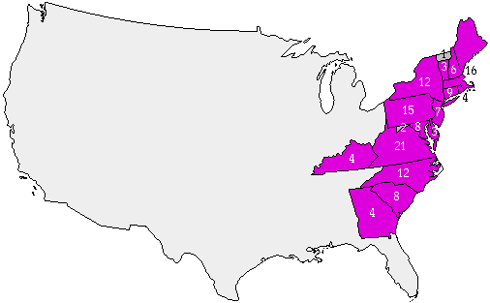
George Washington 1789-1796
1789 Election
1792 Election

Slide 25
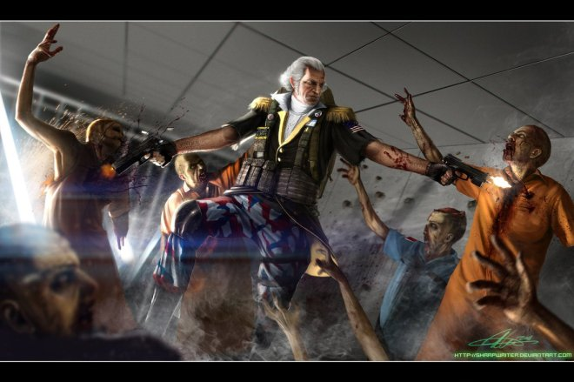
George Washington

Slide 26
George Washington
Washington’s Policies
The 1789 Election was not an election, in the traditional sense. He was nominated infamously. Only ran one true election and that was 1792.
Wanted to reconnect with England and re-tie that relationship
Oversaw, and assisted the French Revolution
Led a Militia against the Whiskey Rebellion – one of two sitting presidents to lead men into combat.
Took a global position in foreign policy
Dealt with Domestic and Foreign Debts.
Set the precedence for two terms, stepped down after second term, much to the chagrin of the people.
Did not want political parties was dead against it.
Establishment of Judiciary
Creation of Cabinets
Won the Northwest Indian War

