Slide 1
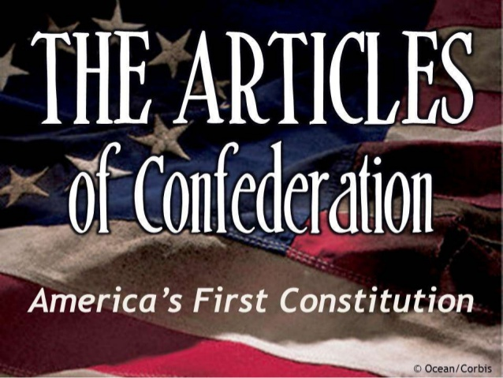
Articles Of Confederation
Unit 3

Slide 2
Articles Of Confederation - Vocabulary
1. Ratify
2. Furious
3. Discontent
4. Unicameral
5. Currency
6. Tariff
7. Creditor
8. Treaty
9. Shay’s Rebellion
10. National Government

Slide 3
Articles Of Confederation – Government under the Articles
Good Ol’ John Dickinson
While the Declaration of Independence was being drafted John Dickinson drafted a plan for what type of government would take the place of England's.
They needed to make plans of how the government would work who would be in charge.
Some believed in a strong national government while others felt state governments should have the most control.
Dickinson’s group won the debate (State’s should have more power)
The plan created a confederation or “League of Friendships” among states.
Articles of Confederation –1781 March it was ratified
Was a list of what the national government could and could not do.
No national court system
No president or king
Single Chamber of legislature
Each state got one vote in Congress regardless of it’s size.
Congress could only do what was specified in the Articles, states could do everything else.

Slide 4
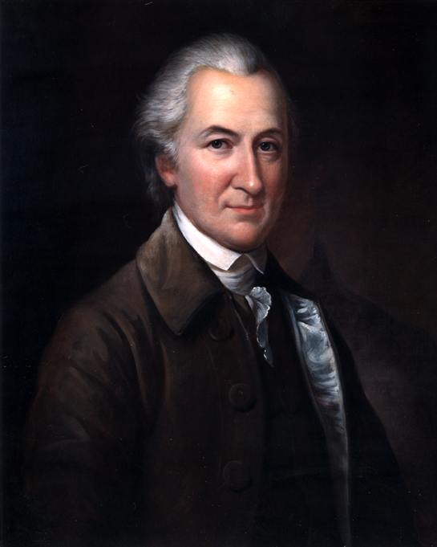
Articles Of Confederation - Author

Slide 5
Articles Of Confederation – What’s in them
National Gov. Could do’s
National Gov. Could not’s
Borrow or request money from states
Declare war and peace
Maintain an Army and navy (if states chose to contribute troops)
Make treaties and alliances with other nations
Regulate affairs with the Native Americans
Establish post offices
Decide certain disputes between states
Coin money (though states could also create their own)
Establish an executive branch, president, or king
Establish a national court
Levy or collect taxes
Require states to provide money for running the national government
Regulate trade
Force anyone to abide by the law
Pass any law without the consent of nine states
Amend the Articles without the consent of all thirteen states

Slide 6
Articles Of Confederation – Problems arise in Confederation Period
After the war
New nation was $40 Million in debt – that’s back then folks.
States were in debt to foreign governments
Soldiers were left unpaid
The biggest problem is all 13 states saw themselves as independent countries
They would refer to themselves as Virginians’ or South Carolinians’, not as Americans’
Created different currencies which made trade among them very difficult
Tariff’s were charged to rival states
So a farmer in New York had to pay a tax just to sell his goods in New Jersey
International trade agreements were common as well
States ignored the National Governments request to pay off the war debt, didn’t see it as their problem.
Some states like Virginia did pay it’s war debts off and did not want to pay for another states debts to pay off their creditors or people to whom they owed money to.

Slide 7
Articles Of Confederation – A Weak National Gov.
Problems for the future
Congress could do nothing if a state refused its request to provide money
With no standing army, and no power to regulate trade the government was weak and the foreign nations knew it.
Problem became worse when paper money was issued and was worthless due to the value being highly inflated
Little laws were passed because it needed 9 of 13 states to agree on a bill.
It could not enforce the laws it did pass only plead with the states to comply
With no national court system it relied on states to enforce and interpret national laws.
Could not effectively settle disputes when states like Rhode Island “Rogue Island” as it was called threatened the peace and tranquility of the union.
After a few years it became clear the constraints on the national government meant that it simply could not effectively coordinate the actions of the states

Slide 8
Articles Of Confederation – It’s accomplishments
What it did accomplish
A treaty with Britain that recognized American Independence
Land gained from Britain from the Atlantic coast to the Mississippi River, and from the Great Lakes and Canada to what is now the northern boundary of Florida.
Established a fair and consistent way for settling and developing lands west of the Appalachian Mountains – One of the most hotly debated issues of the time.
Congress Passed two laws on this issue
Land Ordinance of 1785 – Allowed the government to survey the town and break it up into townships of equal acreage.
One would be given to public education, the other would be auctioned off providing a much needed revenue source
Northwest Ordinance of 1787 – Once I reached a certain population levels, they could appoint a governor and judges, elect legislators, and achieve statehood on an equal basis with the other states.
Congress also set up the departments of Foreign Affairs, War, Marine and Treasury, each under a single permanent secretary. Thus setting up the cabinet departments under the Constitution of 1787.

Slide 9
Articles Of Confederation – Things are falling a part
Articles are Falling apart
A weak national government eventually would lead to so many more problems
A massive debt crisis unlike any we have seen
Out of control power hungry state debt collectors
Legislatures cheating the system to pay their own debts
Crushing financial pressures on the citizenry
Disputes among states
Boycotts which led to corrupt trade laws
A huge increase in black market sales
Citizens being taken hostage by foreign nations, and forced to become citizens of those countries
An angrier and angrier citizenship
No agreement among delegates
James Madison, Alexander Hamilton, Robert Livingston, and George Washington pleaded to ratify the Articles.
John Dickinson, Roger Sherman, Nicholas Cooke, the rest of the Massachusetts delegation, and all of the Southern Delegation refused.
They pleaded especially with the Massachusetts delegation because the citizenry was getting really upset. I imagined it looked a bit like this…..

Slide 10
Articles Of Confederation – Hysteria

Slide 11
Articles Of Confederation – The move to revise the Articles goes full blown
The Four were right Shay’s Rebellion hits Massachusetts
State government increased taxes even more to pay the state’s war debt. Right after a bad harvest, and an economic depression hit the state.
State took land from some, and sent others to debtors prison.
1786 An armed group of farmers marched to several courts and closed them down. Preventing them from hearing foreclosure proceedings.
Daniel Shays a former captain of the Revolutionary Army led a group of men that closed the Massachusetts state Supreme Court and advanced on a federal arsenal in Springfield.
A state militia group confronted Shays uprising and fired on it, effectively ending it right there.
It did spread to other states forcing creditors to excuse debts, which made them furious
The unrest frightened American leaders who saw the weak national government as vulnerable to anarchy
To the Farmers the government seemed unresponsive to the needs of the people.
Many Americans both in leadership, and in the citizenry wanted to see a stronger national government. Hamilton and Madison their chance.

Slide 12
Articles Of Confederation – A move to revise
1787 – A few months after Shay’s Rebellion delegates from the states began meeting to purpose changes to the Articles of Confederation to help regulate trade and to make the national government more effective
They called for a convention of all states in Philadelphia
Congress gave it’s consent to the meetings for the sole purpose of revising the Articles of Confederation.
Every state but, Rhode Island showed up to the meetings
James Madison, and Alexander Hamilton had no intention to revise the Articles, they wanted to completely abolish them for something stronger, better, safer and more reliable for the people.
It gave way to a new guiding document called the Constitution of the United States of America!

Slide 13
