Slide 1
South America
Geography and Economics

Slide 2
1. Mestizo 11. Patois
2. Megacity 12. Matriarchal
3. Primate City 13. Brain Drain
4. Glyph 14. Quipu
5. Chinampas 15. Mosaic
6. Conquistador
7. Viceroy
8. Caudillo
9. Syncretism
10. Malnutrition
Vocabulary Day

Slide 3
Map Activity
South America Map
  Write each country and it’s capital
  Color lightly – if you wish
Latin America Map
  Color the map based on the climate showing the different types of climates that run through Latin America
  Be sure to label the climates as well
Middle America Map
  Color the map based on the climates showing the different types of climates that run through Latin America
  Be sure to label the climates as well
Mexico with it’s states
  Write each state and it’s capitals in Mexico
  Color lightly – if you wish

Slide 4
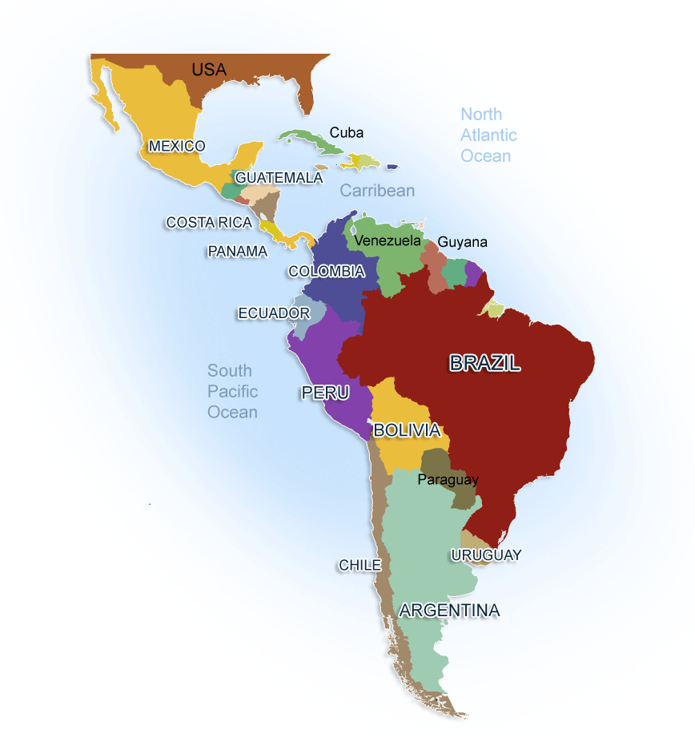
Geography

Slide 5
Geography
II. The Geography of it all
A. The amazon rain forest is located in south America
1. Almost 20% of the amazon rain forest has been destroyed.
a) Logging is the biggest reason for the Rain Forests destruction
2. the amazon plays a crucial part in both the wildlife
of South America, but also the resources it provides.
3. The rain forest is also crucial because its trees and
plants absorb carbon dioxide
B. Laws requiring reforestation can help restore the
forest
1. The united states has more reforestation laws than
all of central, and south America combined.
2. Many of Americans have attempted to bring awareness to the south American government, but they refused to listen or abide by any UN regulations.
3. Without penalty I may add.

Slide 6
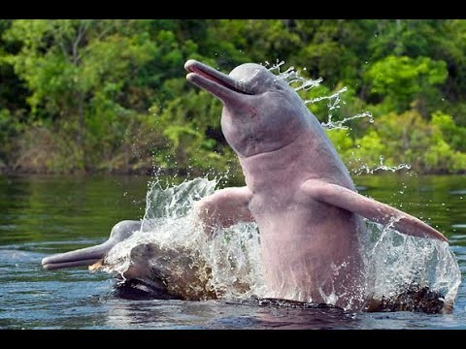
Geography

Slide 7
Geography
Physical Geography of Latin America
  Amazon Basin has the largest Rain Forests in the world
  The Mountain Range located on the Western Edge of South America is the Andes
    It is 1.3 Million Square Miles
  The Rio Grande is a natural divide between the United States, and Mexico
    It is the most traveled water way on the boarder. It also is the least protected from boarder patrol.
  Many islands in the Caribbean are actually Volcanic Peaks
  The Ring of Fire
    Not exclusive to Asia the Ring of Fire stretch all the way to the America’s.
      Along the western coast of South and Central America this region has a large number of volcanos.
  The five climate zones in the highlands are determined by Elevation
    Vegetation of the area
      Most of the rivers are surrounded by Rain Forests
      In Peru the western most region is actually Desert Scrub and Desert waste

Slide 8
Movie Day
Quiz Please sit down and get ready
Be sure to take notes throughout the video might help with notes later
No talking please pay attention

Slide 9
Economic and Government
Movement in South America
  The promise of economic prosperity drew many Brazilians to the rural cities.
  Most of the rural people who move to cities in Latin America are so poor they most often live in Shantytowns
  Rapid Urbanization
    Resources and services become scarce when cities experience this.
  Andean countries of South America experience a unique economic challenge to Bolivia among the Andean countries that’s landlocked.
  Many of the countries in South America try to use Sustainable developments
    The idea that economic and technological growth does not deplete the human, and natural resources of the area
Several cities in Mexico are dominated by foreign-owned factories.
  Two best examples are:
    Tijuana
    Ciudad Juarez
Government
  Most common form is Socialism
    Cuba has the most prominent Communist government on this side of the globe.
      They purchase their homes directly from the Government, not individual buyers

Slide 10
Movie Day 2
Quiz please sit down and get ready
Please take notes it may help later in the unit
Please do not talk

Slide 11
History
Central and South America
  Many Empires have occupied this region, they consist of:
    Mayas
    Incas
    Aztecs
  Conquistadors arrive
    Viewed as Gods were trusted, weapons were primitive
    Spanish scouted the area, knew who the warriors were, and when they slept
      Used all that information to their advantage later attack
    The first European settlement was Hispaniola in 1493.
  Columbian exchange
    The largest contribution to Central America was this Columbian exchange they brought in animals, plants, and more people
      This caused other issues with diseases ,and culture good or bad
  Gaining Independence
    Haiti – Won it’s independence in 1804 from France.
      Haiti would later help other Latin American Countries win independence
    The Caribbean was the last to win it’s independence
      1898 Cuba wins it’s independence from Spain. 1902 it splits from American control
      Jamaica and Barbados not until well into the 1900’s, from Britian

Slide 12
History
Finishing up Central American History
  Puerto Rico – and some on he Virgin Islands
    Still have political links to their respective imperial parents even today.
  A federation of formed called the United Provinces of Central America
    Power elites opposed this, so they separated into five different countries.
      Guatemala
      El Salvador
      Honduras
      Nicaragua
      Costa Rica
  Movements of Change
    Panama becomes independent and makes a deal with the U.S.
    Cuba has a revolution in 1959 that set up a communist state under Fidel Castro.
    During the 90’s Military dictatorships gave way to democracies
      Today many countries in Central America, and the Caribbean are struggling to clean up the corruption.
South America
  Inca’s rule
    They had a strong central government led by an Emperor
    Skilled engineers, built roads, irrigation systems, temples, and so much more.
    The conquistadors were drawn to this wealth and used the network of roads to conquer them.

Slide 13
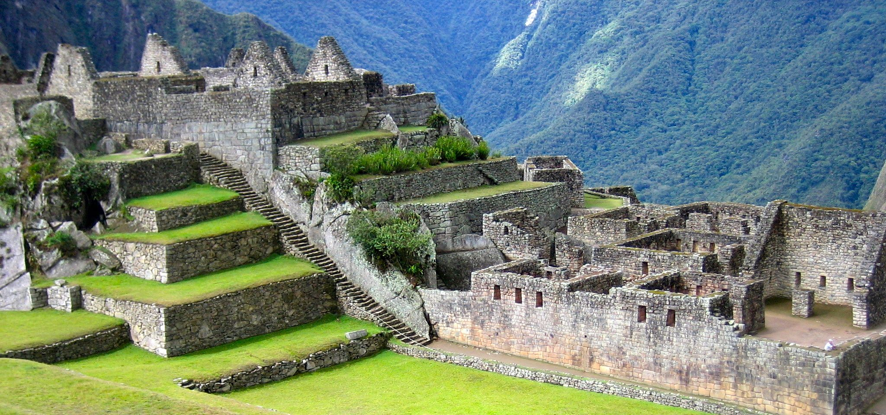
The Incas

Slide 14
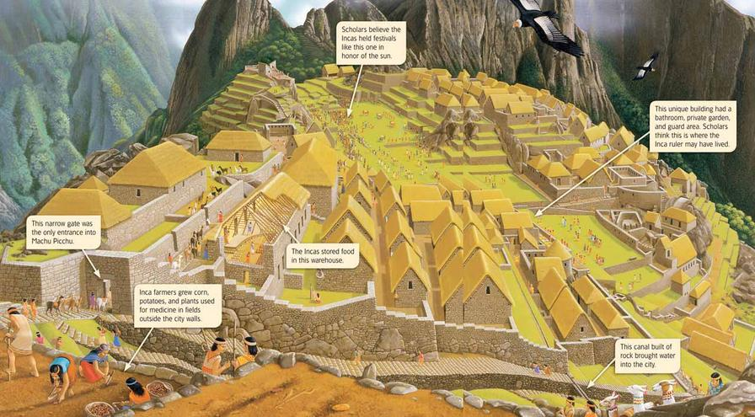
The Incas layout

Slide 15
History
European Conquests
  Same pattern as always
    Spanish seeking wealth invade and conquer
    Plunder and pillage
    Disease runs ramped
    Occupation
Independence
  Several factors excite them to revolt: The French, American, Mexican, and Caribbean revolutions all lead to their eventual revolution
    Leaders such as:
      Simon Bolivar of Valenzuela
      Jose de San Marin of Argentina
    These men by the mid 1800’s had achieved their goal
      Only Brazil became independent without violence

Slide 16
Culture
Language and Facts
  The most common language used in South America is Spanish
  The following all make up South America
    Central America
    The Caribbean
    Lagoons
  Mexico Culture
    Soccer
    Baseball
    Basketball
      The family structure is very important they use a matriarchal relationships: Ruled by a woman or mother
      Social life revolves around the family
      Religion is often a national celebration – Roman Catholic is the largest religious group.
      Major celebrations like the Quinceda is one example
  South American Culture
    Soccer
    Basketball
    Polo
      The family structure is very important called the compadre relationship
      Roman Catholics are the dominate religion in this region as well.
      Relgion is here often a national celebration as well

Slide 17
Quiz # 3
Sit down get a piece of paper out and get ready
Work on the Study Guide
Study Guide review day Monday

