Slide 1
Continental Congress
Creating the Constitution

Slide 2
The Agreements and Compromises
A collection of 55 delegates came together in Philadelphia to work out the issues of this young country.
The Virginia Plan – laid out a strong national government. The plan proposed a government based on three principles
1. The government would have a strong national legislators with two chambers.
The lower chamber to be chosen by the people
The upper chamber chosen by the legislators or the lower chamber if you will
2. A strong Executive would be chosen by the legislator
3. National Judiciary would be appointed by the legislators.
Simply put this would give the larger states more power than the small states, and the party elected would control all three branches.
Lets discuss the Virginia Plan!!!

Slide 3
The Agreements and Compromises
The New Jersey Plan – Small states counter proposal called for keeping two key components of the Articles of Confederation.
1. Government would have a unicameral legislators with each state getting one vote
2. Would keep the country as a confederation of sovereign states
Congress would have new powers however, impose tax, and regulate trade. The Executive would be limited and there would be more than one and would be elected by congress.
The debate wore on not about many things, but state representation really brought it to a halt.
Lets discuss the New Jersey Plan!

Slide 4
The Agreements and Compromises
The Connecticut Compromise – A committee was assigned to find a resolution to the issue. Also known as the Great Compromise. Addressed both the small states issues, and the larger state concerns. Here is the basic of the Connecticut Compromise:
Bicameral system – The Legislative branch would have two houses
A house of Representatives, with the number of representatives being based on each state’s population.
The larger states would have an advantage here being based on population
A Senate with two members from each state being elected by the state legislatures.
The smaller states would have an advantage here with equal representation and state legislatures electing the Senate.
Congress power consisted of :
Impose Taxes
All laws concerning taxes would originate in the House
Lets discuss again shall we?

Slide 5
The Agreements and Compromises
Compromises about the Presidency
Some wanted Congress to elect the president others wanted the people to vote for him
They settled on the Electoral College system which is still in affect today
Terms were also disputed it was ultimately decided it would be a four year term.
George Washington set the precedence for two terms then stepping down. A precedence every president, but F.D.R. would follow.
Other disputes like the power the president has was discussed and settled
The Slave question
The issue was hotly debated back and forth. The North left the issue for discussion down the road, allowing them to readdress the topic at a later date.
The Constitution does not mention the word slave anywhere in the Constitution instead it refers to “importation” of people and “persons held to service or labor”
It did leave the issue vulnerable to be obliterated by law in due time.
Thank you James Madison!!!!! – His, Washington, and Jefferson's forethought, and all of the North for that matter allowed the law to take care of the legality of slavery down the road.

Slide 6
The Agreements and Compromises
Three-Fifths Compromise – Counted the slaves as three-fifths of one person rather than a whole for both taxes, and for representation.
The South’s population was about one-third African American. So the South wanted to count them all as a part of it’s population so they could have more representatives in congress, but then did not want to count them at all for the purposes of levying taxes against their state. It also did not want to count them for the purpose of voting.
The North’s position was simple. If you wanted to count them then let them free and allow them to be counted for tax purposes and allow them to vote. Otherwise don’t count them at all, which in turn counts toward representation as well.
The Three-Fifths Compromise was decided upon.
Commerce and the Slave trade – The South did not want the Federal Government in charge of the exports, and trade specifically the slave trade
The final compromise was to give the Federal Government the power to both regulate interstate commerce and commerce with foreign countries. In return Congress could not ban the slave trade. Congress was also prohibited from imposing export taxes.

Slide 7
A deeper look at some of our Founders
A few quick points

Slide 8
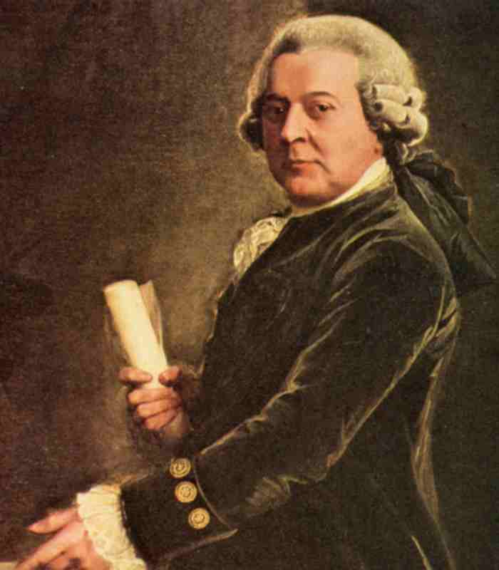
John Adams
Opposed Taxation without representation.
Promoted the establishment of representative state governments
Framed a three-branch government in the Mass. Constitution that served as a model for the federal system.
Believed that the government should use the power given it to meet the needs of the individual.

Slide 9
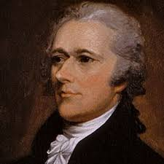
Alexander Hamilton
Ideas on strong central government helped with the shaping and ratification of the constitution.
Distrustful of the masses, Hamilton ensured that state power did not trump federal authority.
Instrumental in establishing a stable financial system for the new nation.
Published the Federalist Papers.

Slide 10
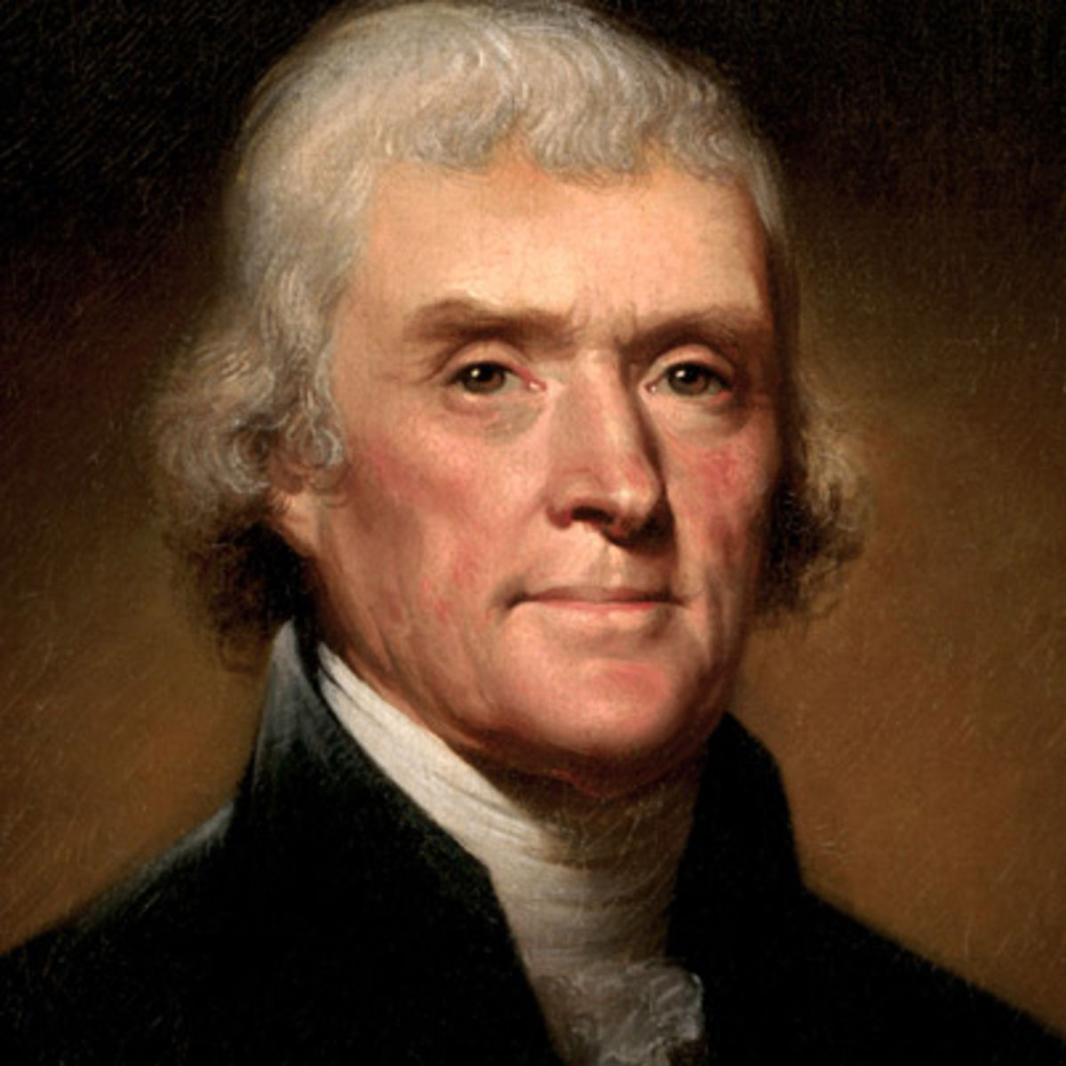
Thomas Jefferson
Wrote the Declaration of Independence, challenging British rule as a violation of natural and human rights
A champion of limited government and religious freedom, Jefferson provided influential support for the Bill of Rights

Slide 11
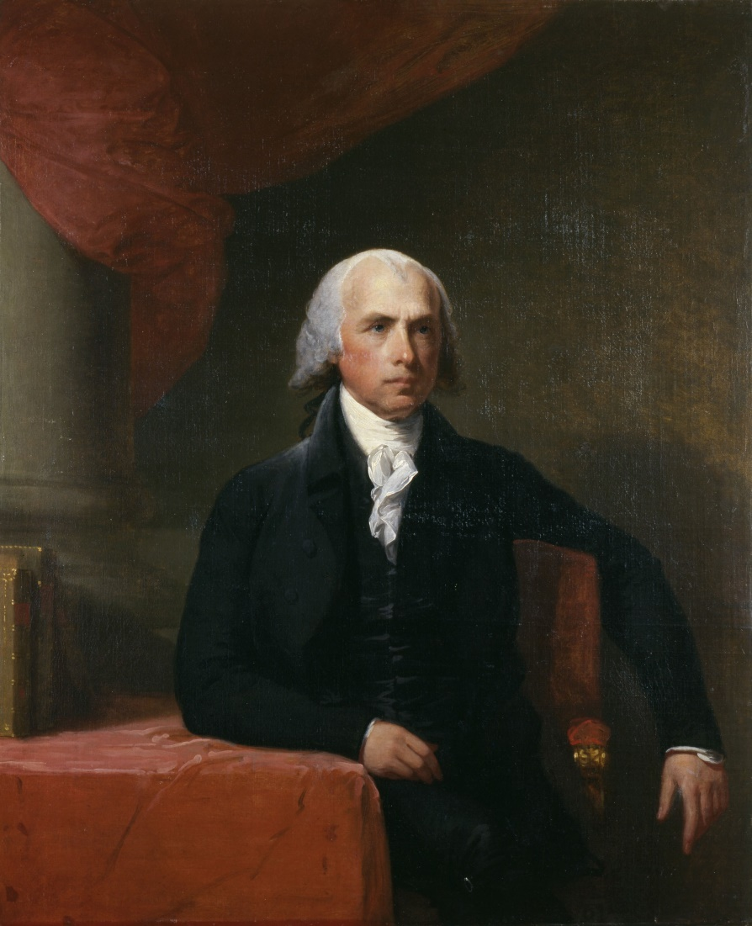
James Madison
The “Father of the Constitution,” Madison promoted the three-branch system of government with separation of powers and checks and balances.
His arguments helped build support for a Constitution with a strong central government.
After ratification he wrote the Amendments that became the Bill of Rights.

Slide 12
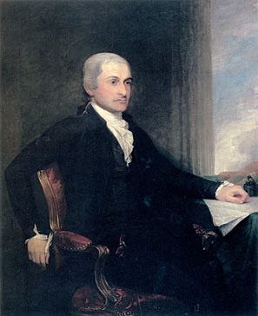
John Jay
Conservative supporter of a strong central government
Helped write the Federalist Papers, promoting ratification of the Constitution.
As first Chief Justice, established protocols for the Supreme Court.

Slide 13
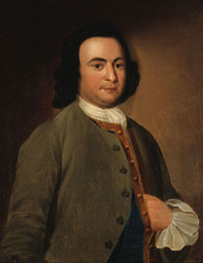
George Mason
Outspoken advocate of individual freedoms.
Wrote the Virginia Declaration of Rights, a precursor to the national Bill of Rights.

Slide 14
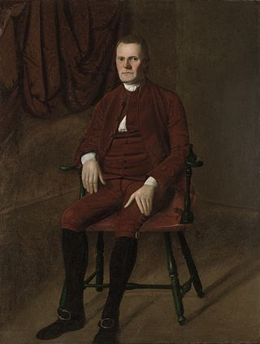
Roger Sherman
Conservative supporter of Independence.
Concerned with process of electing officials and how to balance power with government, Sherman proposed a compromise at the Constitution Convention that led to the adoption of a bicameral legislature with a Senate and House of Representatives.

Slide 15
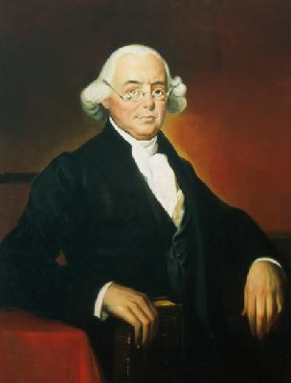
James Wilson
Advocated a strong federal government with three independent branches.
Favored the direct election of members of Congress by the people.
Argued effectively for the ratification of the Constitution.

Slide 16
Ratification and the two sides
Ratifying the Constitution – By September 17th, 1787 the Constitution was complete.
Still was not the law the people needed to Ratify it. The debate lasted almost three years. Rhode Island was the last to Ratify it, while Delaware was the first. New Hampshire was the ninth which officially gave us the two-thirds states we needed to have it go into effect. This occurred in June of 1788.
Federalist who where they?
Mostly the Founding Fathers, but also included merchants and other citizens in the cities, and coastal regions.
They argued that a Bill of Rights was not necessary because the government already recognized, individual liberty in both the Declaration, and in all the State Constitutions.
Anti-Federalist who are they?
Led by the likes of Patrick Henry, and John Dickinson, also included inland farmers, and laborers who feared a strong central government
They argued that without a Bill of Rights the people were unprotected from their own government.
Ratification turn toward Independents with a promise
The Federalist promised as the first order of business when the new government met, that they would add the Bill of Rights.

Slide 17
The New American Government
Once it was established the following took place:
George Washington was Elected President
John Adams was Elected Vice President
Voters also elected their house of representatives.
March 4th 1789 Congress met for the first time in Federal Hall in New York City
James Madison introduced a set of Amendments during the first session. Congress approved 12
10 were ratified and the Bill of Rights was born.

Slide 18
A few parting thoughts
Elastic Clauses – Law that lets Congress stretch its power to meet certain situations.
Jurisdiction – Court’s authority to hear certain kinds of cases
Judicial review – Court’s ability to interpret the Constitution and overturn laws that violate the Constitution.
Enumerated Powers – Powers that are listed by number in the Constitution.
Levying Taxes is an example of this.
Why did Hamilton write the Federalist Papers
To alert the public
Founders solved the all too-powerful military by putting it under the executive branches control.

