Slide 1
Structure and principles of Government
A quick set of notes

Slide 2
Structure of the U.S. Constitution
Article I – The Legislative Branch
  Establishes the Legislative branch to make laws
Article II – The Executive Branch
  Establishes an executive branch to carry out the laws that Congress passes
Article III – The Judicial Branch
  Establishes the judicial branch and the Supreme Court to head it
Article IV – Relationships among the States
  Describes the relationship of the states to the national government and to one another
Article V – The Amendment Process
  Explains how the Constitution can be amended, or changed
Article VI – National Supremacy
  Contains the Supremacy clause – Supreme Law of the Land
Article VII – Ratification of the Constitution
  Address the Ratification of the Constitution.

Slide 3
Principles of the Constitution
Popular Sovereignty and Republicanism
  Rule by the people
  Government is based on the consent of the governed
  Government authority flows through the people
  People elect representatives to rule on their behalf
No where in the Constitution does it say the word democracy an important fact to keep in mind
“What type of government did you give us Dr. Franklin?”
“A Republic ma’am, if you can keep it.”

Slide 4
Principles of the U.S. Constitution
Limited Government
  Fundamental principle to our Republic
  Constitution limits the power of the national government by specifying its powers
  Also specifies what the government can, and can not do.
“A government is limited only if you pay attention to it and watch it. For if you do not than the government becomes as fat as old George.” – John Jay

Slide 5
Principles of the U.S. Constitution
Federalism – The basic structure of the American government system
  Power is divided between federal, or national, government, and the state governments
  Local governments are under the authority of the state government.
    All levels of government pass their own laws
    Have their own agencies
    And officials to implement the laws
    Have their court systems
  This system if flexible and allows national government to act on issues that affect the country as a whole, while allowing state and local governments to act on local matters

Slide 6
Separation and Checks
Separation of Powers
Checks and Balances
The division of power between the three branches.
Each branch has specific duties in the government
Idea is to prevent any one branch from becoming to powerful.
The key is the branch must demonstrate its power, something modern day politics does not do.
Congress passes laws, but the President can veto the law.
Congress can override a veto by two-thirds vote in both House and Senate.
Judicial branch can over-rule either by judging the Constitutionality of the law.
Judicial Branch is checked by Article V

Slide 7
Individual Rights
The Constitution in regards to our Individual rights
  Constitution protects individuals from government overreach
  The Bill of Rights – Guarantees these freedoms. By listing the rights the GOVERNMENT SHALL NOT INFRINGE UPON!
    Obviously they do, yes even our freedom of speech. Easily fixed, but one must educated to do so.
    Let’s discuss for a moment (Best example the banning of words)
  These rights while not unlimited, but as all individual rights go there must be a balance with the government’s need to provide for the public good.
    The consensus says they can limit our speech to maintain order
      Can they? Has it gone to far? Are we over sensative.

Slide 8
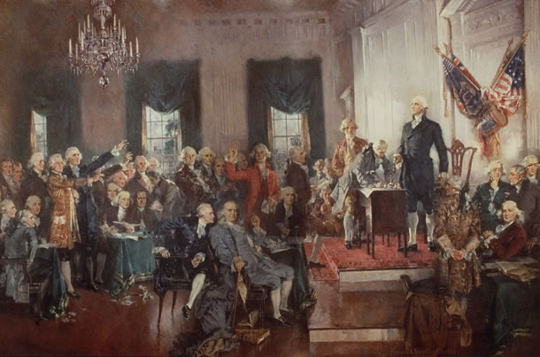
Lets have our own Debate shall we?

