Slide 1
Basic Geography
The Final Set

Slide 2
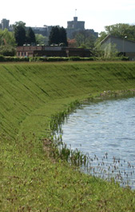
Basic Geography I
  Animism – Belief that animals have spirits
    Native Americans have a strong belief in this system
    Stories of Animals showing their spirit
  Bartering – Exchange of goods instead of money
    Haggling is the arguing over the price
    Early on all we knew was the Barter system
  Mercantilism – An Economic system based on trading with the mother country
  Imperialism – Political and economic domination, to control markets. Britain did this first all over the world but, nowhere more impactful than in India
  Embankment – A wall of soil and rock that holds back water is a natural dam if you will

Slide 3

Basic Geography I
  Nuclear family – A social unit composed of two parents and one or more children
  Cottage industry – A usually small-scale industry on or at a home by family members using their own equipment
    Common in the U.S. more than any other country
  Megalopolis – A city and its surrounding area
  Archipelago – Chain of islands

Slide 4
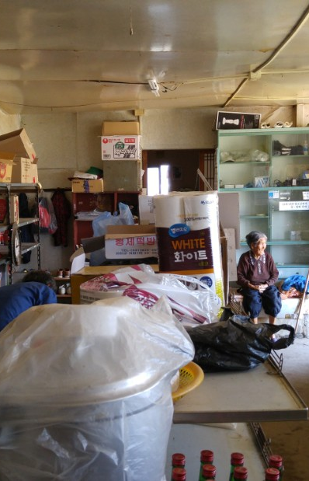
Basic Geography I
  Total Fertility Rate – The total number of children a woman has in her lifetime
    Average U.S. Family has gone down from 4.5 children per household to 2.1 per household
  People discuss population control this can only mean one of three things
    1 – Mass murder
    2 – Mass sterilization
    3 – Child birth restrictions like China
  DMZ – Demilitarized Zone
    China, North Korea, Iraq, among others
  Cultural Convergence is the coming together of two cultures

Slide 5
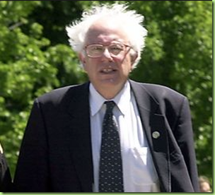
Application Time!! Q& A

