Slide 1
Europe
Geography

Slide 2
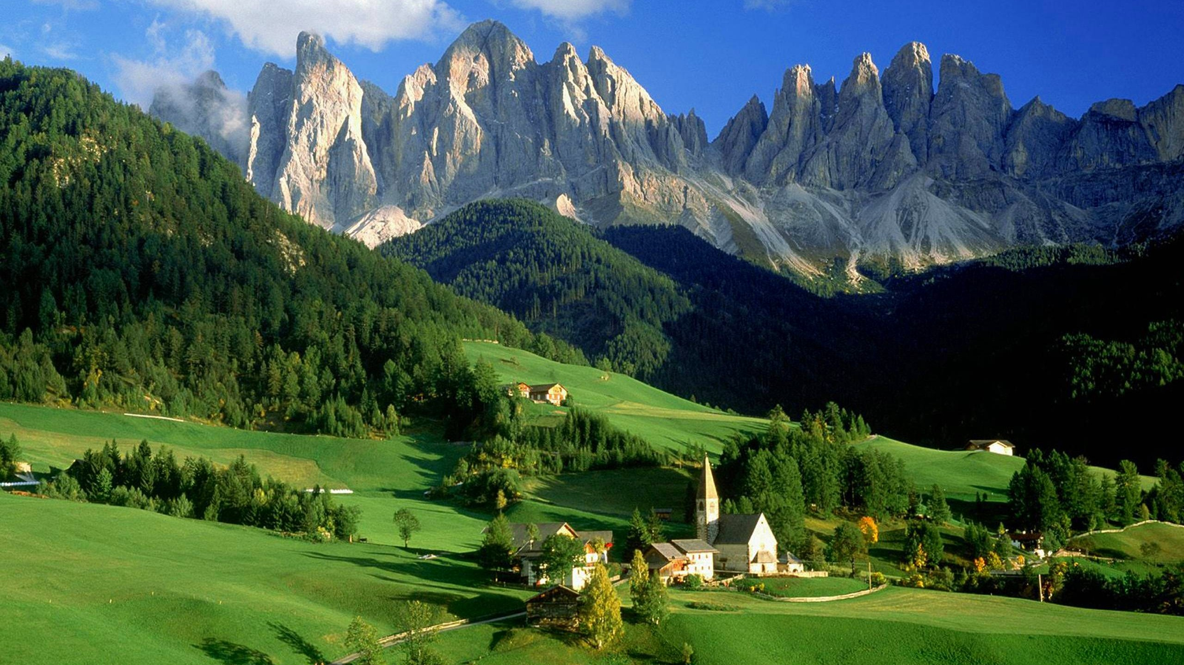
> The tall peaks of the Alps block the winds carrying moisture from the North Atlantic
This geographical feature is responsible for Millan’s hot and dry climate.
> The alps has acted as a major defense point for the roman empire during its 507 year reign.

Slide 3
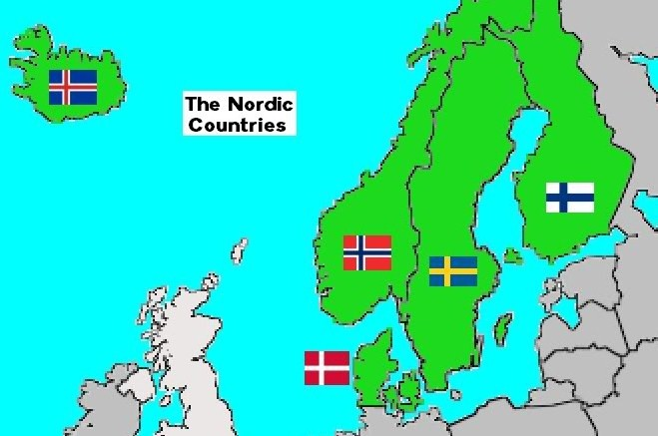
> During the midsummer of the northernmost territories of the Nordic nation the sun never sets for weeks at a time.
> The Nordic nations are home of the Vikings who are truly the first Europeans to find the Americas.
> Eric the red found both Greenland (Which is all ice) and Iceland (which is mostly a green lush country) as well as the northeast united states.
> The Vikings were a violent feared group who were skilled fighters many equate them to the Spartans in fighting prowess.

Slide 4
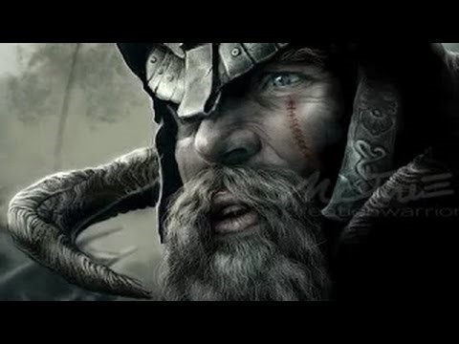
> More Europeans earn a living farming than any other economic activity.
> Most of Europe's landscape is conducive to farming.
> many Europeans oppose new agricultural technologies such as genetically modified crops.
> some European farmers are growing crops using natural substances instead of chemicals, a method known as organic farming.
> free trade agreements have given rise to inefficient factories, whose pollution hurts the environment in neighboring nations

