Slide 1
Europe
History, a quick overview

Slide 2
European changes

Slide 3
History
Irish Potato famine wiped large Irish populations- Through both death and exodus
The Irish economy depended heavily on potatoes, and this blight wiped out the potato crop in the 1840’s causing mass famine
This had no effect on it’s industrialized neighbors Great Britain
Through many wars, and leaders France has remained a power in Europe since all the way back to Charlemagne
This has allowed France to maintain a strong sense of national identity over the years
The Industrial Revolution
Started in Europe and made Europe the birthplace of modern industry
Europe’s early industrialization was sparked by its abundance of coal and iron ore.

Slide 4
History
Bosnia-Herzegovina was a nation of conflicting ethnic groups in the late 1900’s
WWI starts with a bang- the assassination of the Arch Duke Franz Ferdinand
WWI ends once the U.S. enters the war.
WWII started due to a comedy of errors
The main causes of WWII
1st - The treaty of Versailles
2nd – A weak Prime Minister of England allowed for Germany to run rough shad with no intention of identifying them as an enemy rather seeking appeasement to achieve peace
3rd – No clear plan to stop Hitler outside of appeasement. Neville Chamberlain refused to acknowledge he could be wrong.

Slide 5
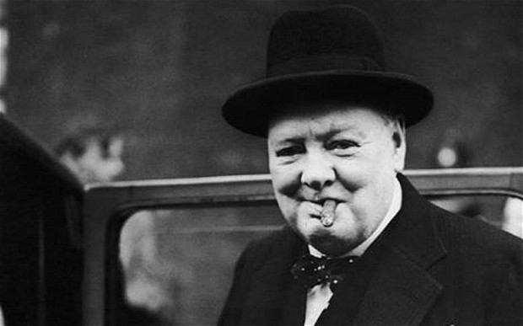
1. Neville Chamberlain said after appeasing Hitler for the third time “Finally there is peace in our time.” 2. Three months later Hitler invaded Poland 3.. Once Hitler invaded Poland WWII was on, and Chamberlain had no idea how to act militarily 4. People of England elect a conservative by the name of Winston Churchill to fight Hitler Winston Churchill Adolph Hitler

Slide 6
1. Churchill is credited with keeping England going by winning several key battles, though he lost many more than he won from 1939-1940. He did listen to many of his generals which saved him in both Operation Sea Lions – German land invasion attempts on England. 2. Hitler's big three mistakes, that cost him the war. 1. Sending out the Bismarck without a fleet. 2. Stopped bombing England’s airfields. 3. Attacked Russia, causing a war on two fronts. 3. After WWII ended Europe moved toward unity to rebuild their economics.

