Slide 1
North American GEO
Climates and the Dust Bowl

Slide 2
North America GEO
Climate
A. Canada
1. Cold – Desert
2. Light Summer cool temps range from 70-85 degrees
B. United States
1. N.E. – Cold Wet/Humid Wet #23
2. S.E. – Cold Wet/Humid Wet
3. M.W. – Cold Cold/Warm Wet
4. S.W. – Cold Dry/Hot Dry
5. N.W. – Very similar to Canada/ Similar to Canada
6. P.C. – Cold wet/Dry Wet cooler overall in the summer

Slide 3
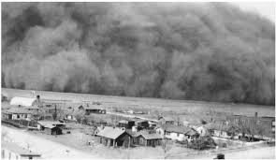
Dust Bowl
C. Dust Bowl
1. Constant planting
2. Unseasonably windy removed the top soil
3. Dry season caused the destruction known as the Dust Bowl
4. All of these factors led to the dust bowl

Slide 4
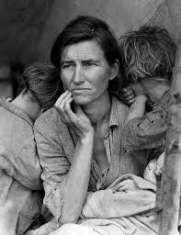
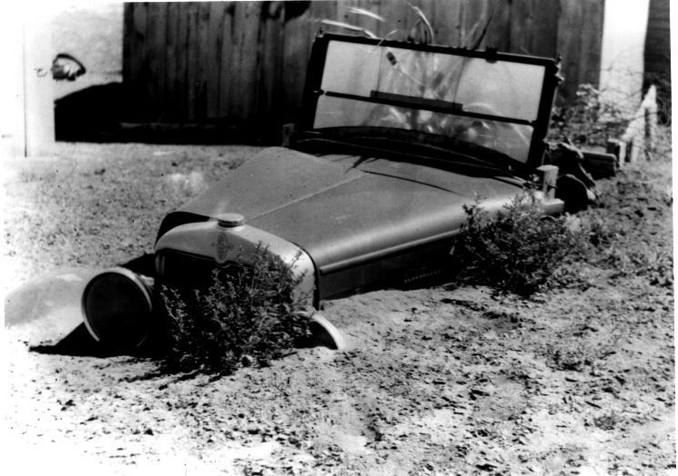
Pictures of the Dust Bowl
Dust Bowl
Dust Bowl effects

