Slide 1
Factors affecting climate & World Climate
A lesson in contradictions

Slide 2
Factors affecting climate
L.E.C. – Latitude, Elevation, and Climate
Latitudes have three levels.
Low which is between 30 degrees South and 30 degrees North. Low receives direct sun ray’s year round. Includes Equator, Tropic of Cancer, and Capricorn
High which ranges from 60 degrees North to 90 degrees North, and 60 degrees South to 90 degrees South located on the poles
Midlatitudes are the most variable weather patterns on Earth. Ranges from 60 degrees North and 60 degrees North in the Northern Hem, and between 30 degrees South, and 60 degrees South in the Southern Hem.
Elevation – influences climate in every direction and at all latitudes.

Slide 3
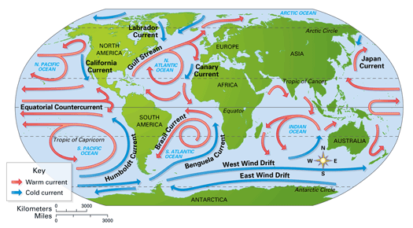
Factors affecting Climate
Wind Patterns, two types we will look at in particular
Prevailing Winds – a very consistent wind pattern. These are normal patterns people can rely on.
Coriolis – Changes the prevailing winds to blow diagonally rather than their normal North, South, East, and Western directions.

Slide 4
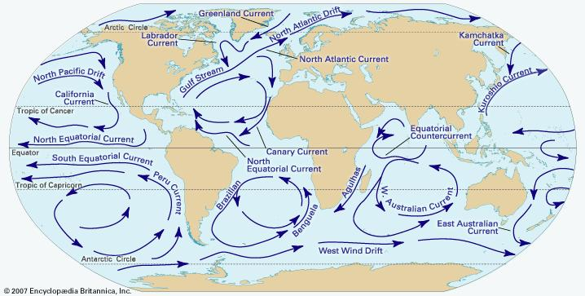
Factors affecting Climate
The Horse Latitudes
The area where it is generally windless is known as the doldrums
Ocean currents – Like in finding Nemo, there are jet Strems in the water that go long distances. This is called the ocean’s current.

Slide 5
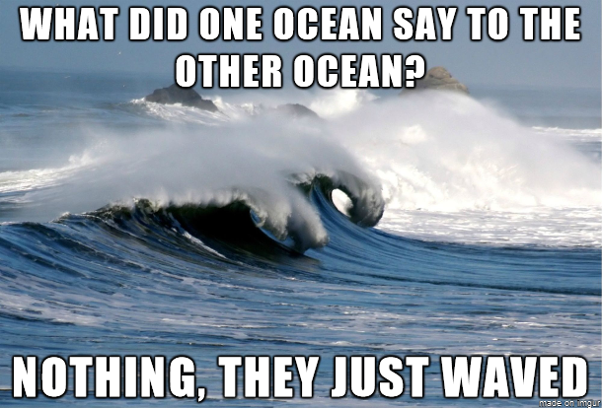
Factors affecting the climate

Slide 6
Factors affecting the climate
Landforms and climate – landforms also affect the climate. Three key terms to know in this regard.
Windward Side – Simply put this is the side of the mountain facing the winds
Leeward Side – The opposite side of the mountain. Tends to be hot, dry, and has little perception.
Rain Shadow Affect – This is the result of being on the leeward side, it is very hot, dry, and produces little to no moisture.

Slide 7
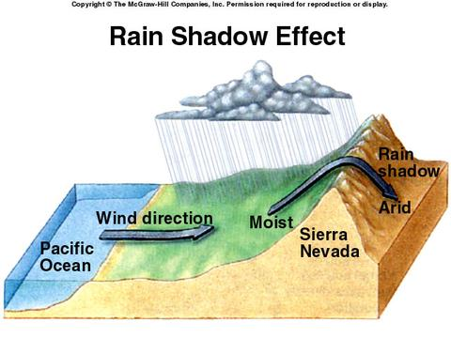
Factors Affecting climate
The Rain Shadow affect

Slide 8
World Climate Patterns
Climate regions – Several types to mention here
Tropical Climate – known as the tropics has two types that are most common.
The Tropic Wet – which produces 80 in of rain a year
The Tropic Dry – These tend to have dry winters, and wet summers.
Dry Climates – This also has two types
Desert – can include ice deserts. It simply means little to no perception occurs here.
Steppe – like deserts these occur in low latitudes, and midlatitude regions.
Midlatitude Climate – Four types of weather patterns
Marine West Coast – brings cool summers, and cold wet winters.
Mediterranean – warmer weather has short trees, or scrub vegetation.
Humid Subtropical – short mild winters, and nearly year round rain. Like Florida, or the Southeastern U.S.
Humid Continental - Inland areas, where the ocean winds have little to no effect on it’s climate.

Slide 9
World Climate Patterns
High – Latitude Climates – This has three very harsh types of temperatures.
Subarctic – Bitterly cold winters, and summers are short and cold
Tundra – Winter darkness and extreme cold last for several months. The direct sun ray’s during long summer days have a limited effect on warming it up.
Ice Cap – Has snow and ice 2 miles thick constantly cover the surface. Monthly temps average below 0.
Highland Climate – High mountain areas even along the equator make the weather sporadic.
Highland – Mixed forests lie in this area, as well as mixed weather patterns.

Slide 10
World Climate Patterns
Climate change…..err I mean Global Warming…….err I mean Global freezing……whatever lets discuss.

Slide 11
