Slide 1
Water
A unit out of this world

Slide 2
Forces of Change
Earth has three layers
Core – the center of the earth
Mantle – the area just outside the core, produces 80% of the heat generated by the Earth
Crust – The outer layer of the Earth’s surface
The ground literally moves – Pangaea everything was connected
Continental drift – Continents were once joined and slowly drifted apart.
Plate Tectonics the Earth is on moving plates. Each continent has it’s own plate.

Slide 3
Forces of Change

Slide 4
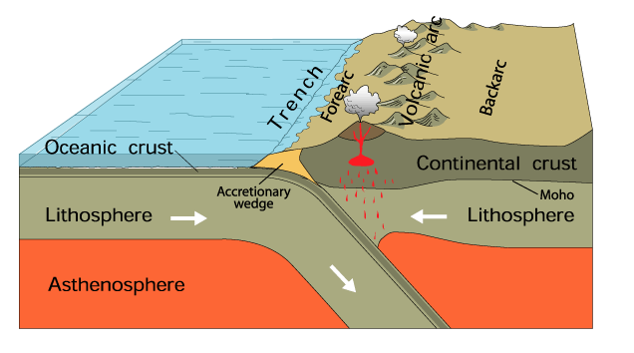
Forces of Change
How did it all happen?
Three ways the continents break apart
Subduction – the colliding of two plates. The Himalaya’s were formed when the Indian plate collided with the Asian plate.

Slide 5
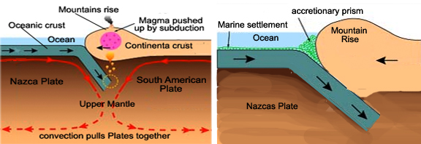
Forces of Change
Three ways the continents break apart
Another form of subduction called accretion that is when a sea plates slides under the continental plate.

Slide 6
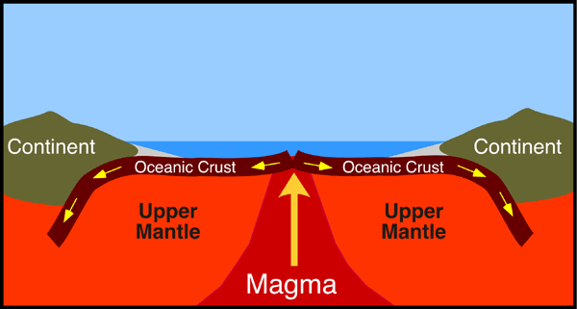
Forces of Change
Three ways the continents break apart
Spreading – A rift occurs or deep crack allowing magma to seep up between the plates, and pull them apart.

Slide 7
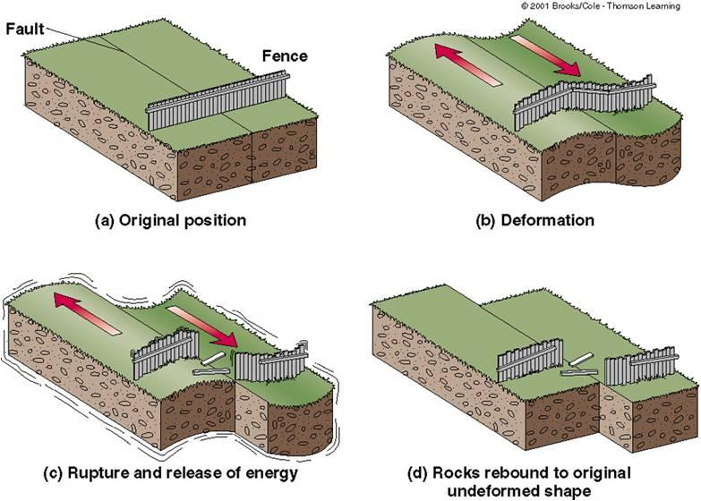
Forces of Change
Three ways the continents break apart
Faulting – The rubbing of two plates, they slide into and away from each other. The San Andreas is this type of plate. Sorry folks no ocean front property in Arizona.

Slide 8
Forces of Change
External forces of Change
Weathering and erosion – these two work hand in hand. Weathering breaks it apart, while erosion wears it away.
This happens three ways – 1. Wind 2. Glaciers and 3. Moving Water
Weathering can happen two ways:
Physical – Water seeps into rocks freezes, cracking them like an egg.
Chemical – Rainwater gets into a rock and changes the chemical make-up of the rock, like Limestone.
Erosion happens three ways:
Wind – Movement of dust, sand, and soil from one place to another
Glacial – Large bodies of ice that move across the earth’s surface.
Water – Springwater, and rainwater flowing in streams cuts into the land and wears it away

Slide 9
Forces of Change
Create your own Pangaea – Using what you know about plate movements, how do you see the plates moving the Earth in say a billion years from now?

Slide 10
Water
Water Cycle – Regular movement of water. These are all apart of the Water Cycle
Evaporation – changing of liquid water into a vapor or gas
Condensation – Vapor changes into liquid water
Precipitation – Water dropped from the sky do to cloud pressure. Can be in the form of rain, snow, or sleet.

Slide 11
Water Cycle

Slide 12
Water

Slide 13
Water
Bodies of Salt Water
Other forms of Water
Pacific
Atlantic
Indian
Artic
Mediterranean Sea
Gulf of Mexico
Desalination – the turning of Salt water into Freshwater
Lakes
Streams
Rivers
Groundwater

Slide 14
Climate and Weather
A unit out of this world

Slide 15
Climate and Weather
Climate- simply put is weather patterns that are common to an area over time.
Arizona for example is a desert
Weather – Conditions of the atmosphere in one place for a short period of time
Rain or snow is weather
The Earth is Tilted and rotates on that tilt.
The tilt affects the temperature of the earth
Earth’s revolution – No not that kind of
revolution. The earth takes 365 days to
complete one revolution, trip around the
sun.

Slide 16
Climate and weather
A few key terms to understand
Equinox – Both the day and night have equal hours. This occurs on March 21st
Tropic of Cancer – The Northern Hemisphere experiences it’s longest day of the year on June 21st.
Summer Solstice – Same thing it is the official beginning of Summer in the Northern Hemisphere
Tropic of Capricorn – Occurs on December 22nd this marks the shortest day of the year and marks the beginning of winter
Winter Solstice – Name given to the beginning of winter season.

Slide 17
Climate and Weather
Describe your favorite part about summer, and winter, draw a picture if you wish, we will share in a bit.

