Slide 1
Our Solar System
A unit out of this world

Slide 2
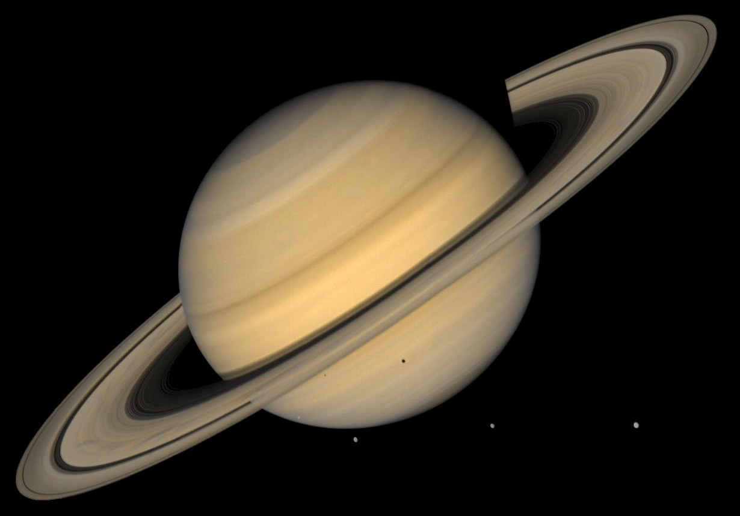
Solar System Video
https://www.youtube.com/watch?v=HUSIOOnuw0U
Notes:
This video will take most of the period so be sure to do the Quote of the Day and get seated right away

Slide 3
Conversation Day !!!
Notes:
Two quick things to think about. 1. Are we alone? 2. Can we ever figure out a safe way to travel long distances in space?

Slide 4
Vocabulary Day !!
Asteroids 14. Magma
Dwarf Planets 15. Fault
Hydrosphere 16. Erosion
Lithosphere 17. Water Cycle
Atmosphere 18. Evaporation
Biosphere 19. Condensation
Continental Drift 20. Precipitation
Core 21. Desalination
Mantle 22. Ground Water
Crust 23. Aquifer
Subduction 24. Green House Effect
Accretion 25. Revolution
Plate Tectonics 26. Solstice
Notes:
Once finished draw your favorite planet and three facts about it, as well as three reasons you picked it.

Slide 5
Our Solar System Notes
Eight or Nine Planets?
Mercury
Venus
Earth
Mars
Jupiter
Saturn
Uranus
Neptune
Pluto?

Slide 6
Our Solar System
Mercury
Facts about Mercury
Closest to the Sun
Day time High’s 437 degrees
Night time Low’s -173 degrees
Most Extreme temp changes in universe
A very Thin Atmosphere

Slide 7
Our Solar System
Venus
Facts about Venus
More volcanoes than any other planet
A day on Venus is 243 Earth Days
Earths Twin
870 degrees
Brightest planet in the Solar System

Slide 8
Our Solar System
Earth
Facts about Earth
Standing on that equator you would be spinning around Earth's center at 1000 miles per hour.
Our Poles flip occasionally
70% is covered in Seas
Earth once had 2 Moons

Slide 9
Our Solar System
Mars
Facts about Mars
Mars had water in ancient times
Mars has frozen water today
We have pieces of Mars on Earth
Mars used to have a thicker atmosphere

Slide 10
Our Solar System
Jupiter
Facts about Jupiter
Jupiter can’t become a star
Jupiter has 67 Moons
Spins faster than any other planet
Can see it with your own eyes
Jupiter has Rings

Slide 11
Our Solar System
Saturn
Facts about Saturn
Saturn is the least dense planet in the universe
Only visited four times by space crafts
Has 62 Moons
Rings sometimes disappear
Life could be near Saturn

Slide 12
Our Solar System
Uranus
Facts about Uranus
Often referred to as the Ice Giant
Coolest temperatures -224 degrees
Has two very thin dark colored rings
Only one space craft has ever flown past Uranus

Slide 13
Our Solar System
Neptune
Facts about Neptune
Smallest of the Gas Giants
Surface gravity is almost Earth Like
Strongest Winds in the Solar System
Neptune also has rings
Captured it’s moon Titan

Slide 14
Our Solar System
Pluto
Facts about Pluto
Has five moons
Declassified as a Dwarf Planet
Largest of the Dwarf Planet
One Third Water
Sometimes has an atmosphere
Is it or isn’t it?

Slide 15
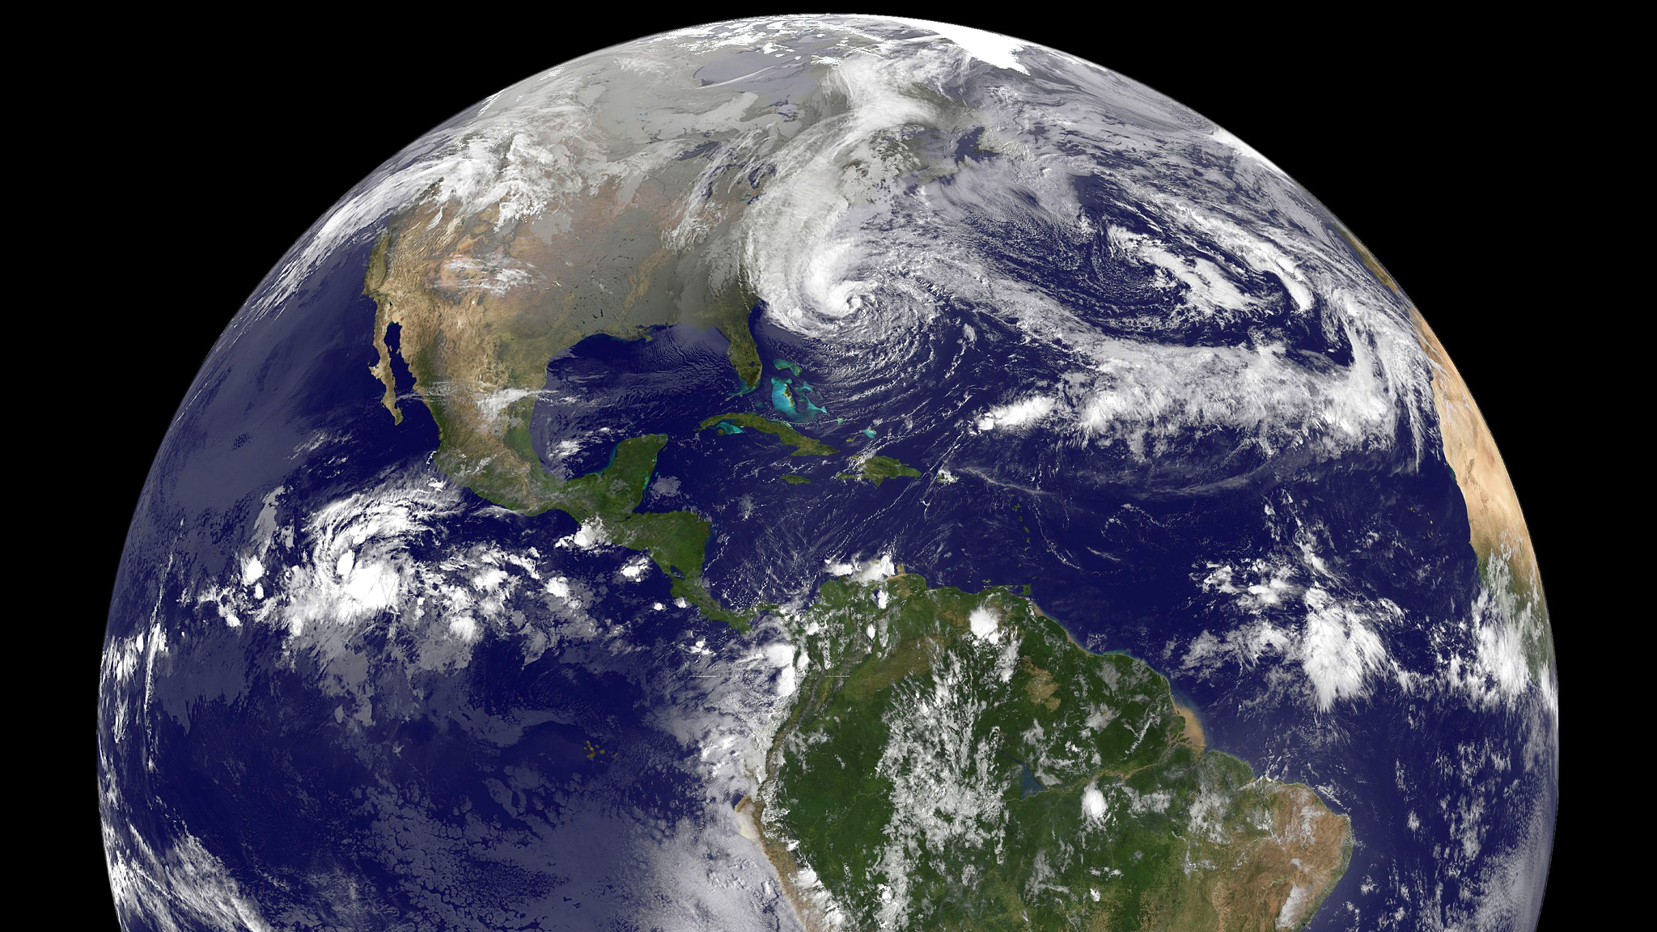
Earth – A closer look

Slide 16
Earth
Globe is a scale model of Earth
A printed map is a symbolic representation of all or part of the planet
Cartographers – mathematical formula to transfer 3-D to 2-D maps
Great Circular Route – Traveling along a great circle: Um Duh?!
Three types of Projections
Planar – Straight line coming from the center to any point
Cylindrical – Projection of globe onto a cylinder
Conic – Placing of a cone over a limited east-west area to take a deeper look
Notes:
Get their books off the shelf.

Slide 17
Earth
Five types of ways to determine location
Latitude – Parallel lines that circle the earth. These are parallel to the Equator.
Equator – is measured at 0 latitude
Longitude – These lines circle the earth from pole to pole. These lines run parallel to the Prime Meridian
Prime Meridian – is measured at 0 longitude
Global Grid – Absolute location, where the longitude and latitude lines exactly cross
Northern and Southern Hemisphere – North of the Equator is Northern Hemisphere, south of it is Southern
Eastern and Western hemisphere – Everything East of the Prime Meridian is Eastern, and West of the Prime Meridian is Western

Slide 18
Earth

Slide 19
Earth – Reading a Map
Title – what information the map is showing you.
Scale Bar – Shows relationship between map measurements and actual distances
Compass Rose – indicated the four Cardinal Directions (North, South, East, and West) Also includes the intermediate directions (Northeast, Northwest, Southeast, and Southwest) usually indicated by an arrow or points on a star
Cities – Names of cities on a map
Capitals – What those countries capitals are.
Key – lists or explains any symbols, colors, or lines that the map is trying to portray. Sometimes called a legend
Boundary Lines – Highlight boarders between different countries

Slide 20
Earth – Scale Maps & Physical Maps
Small-Scale Maps – shows a large area but with little detail
Large-Scale Maps – shows a small area with a great amount of detail
Physical Maps – Shows the location and topography or shape of the Earth’s features.
Topography – Shape of the Earth’s land features
Water features – shows rivers, streams, lakes, and other water features
Landforms – shows mountains, plains, plateaus, and valley’s
Relief – Maps use different shading or textures to point something out
Elevation – shows the height of landforms, and in relation to sea-level

Slide 21
Earth – political & Thematic Maps
Political Maps – Shows boundaries and locations of political units such as countries, states, counties, cities, and towns. Most are human made
Human Made – Roads, highways, capitals, and railroads to mention a few
Physical features – rivers, mountains, ext.
Nonsubject Area – Area’s surrounding the subject to give context to what you are studying
Thematic Maps – Focuses on a single idea or has a particular kind of information
Qualitative Maps – These use colors, symbols, lines, or dots to show relative information
Flow-Line Maps – Maps that identify the movement of people, animals, goods, or ideas. Also can include the physical like hurricanes, and glaciers.

Slide 22
Earth – Geographic information Systems (GIS)
GIS – is used to accept data from different sources then converts it into a digital code. Programmers then process the data and produce maps
First layer – Pinpoints areas of interests
Second Layer – Information added based on problem, or issue being studied
Final Layer – Complex information is added, the addition of more layers can occur here as well.

Slide 23
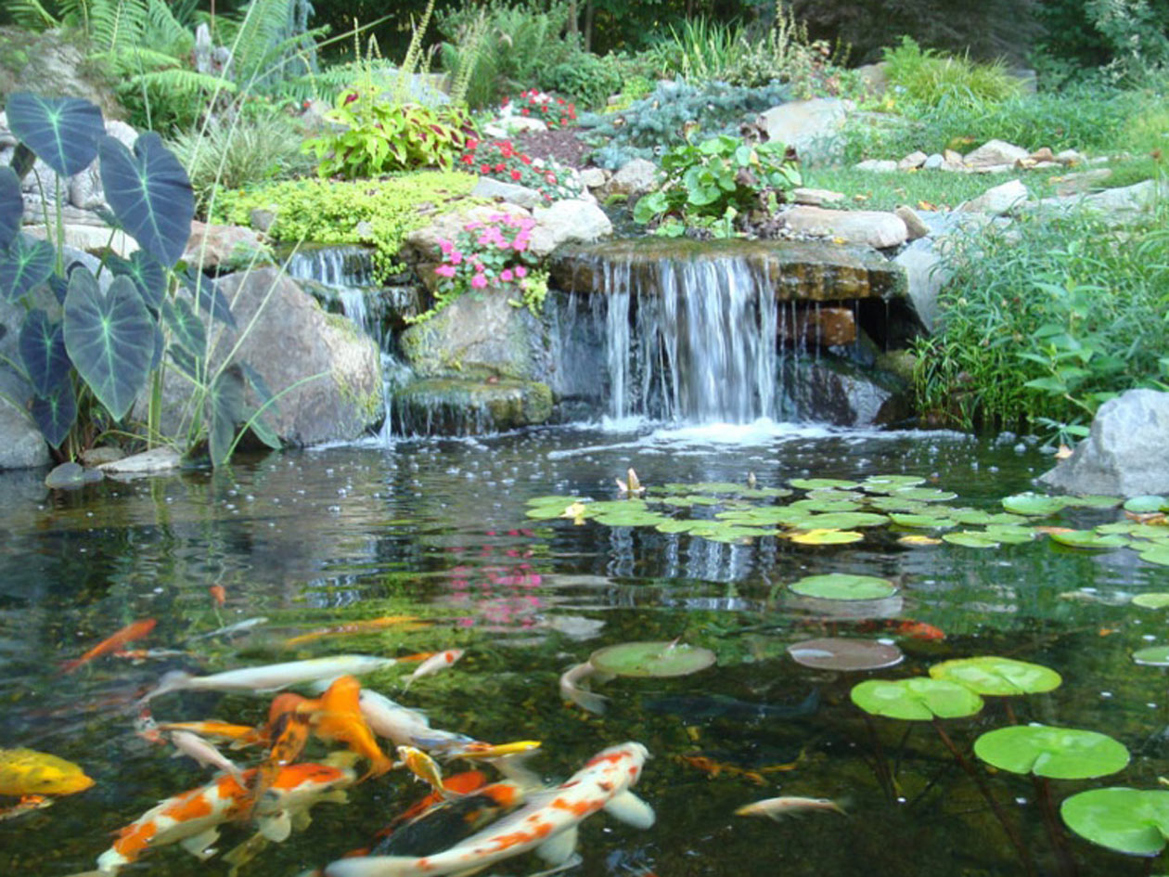
Earth – Elements of Geo
The world in spatial terms
Places and regions
Physical Systems
Environment and Society
The Uses of Geography

Slide 24
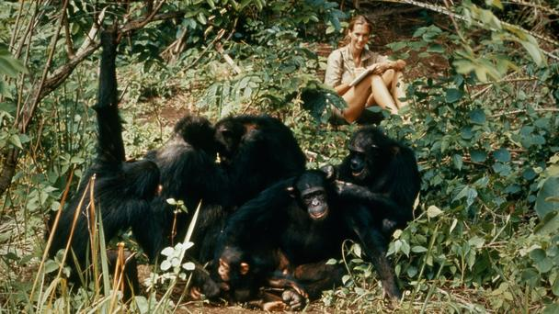
Earth – Research Methods
Direct observation
Mapping
Interviewing
Analyzing Statistics
Using Technology

Slide 25
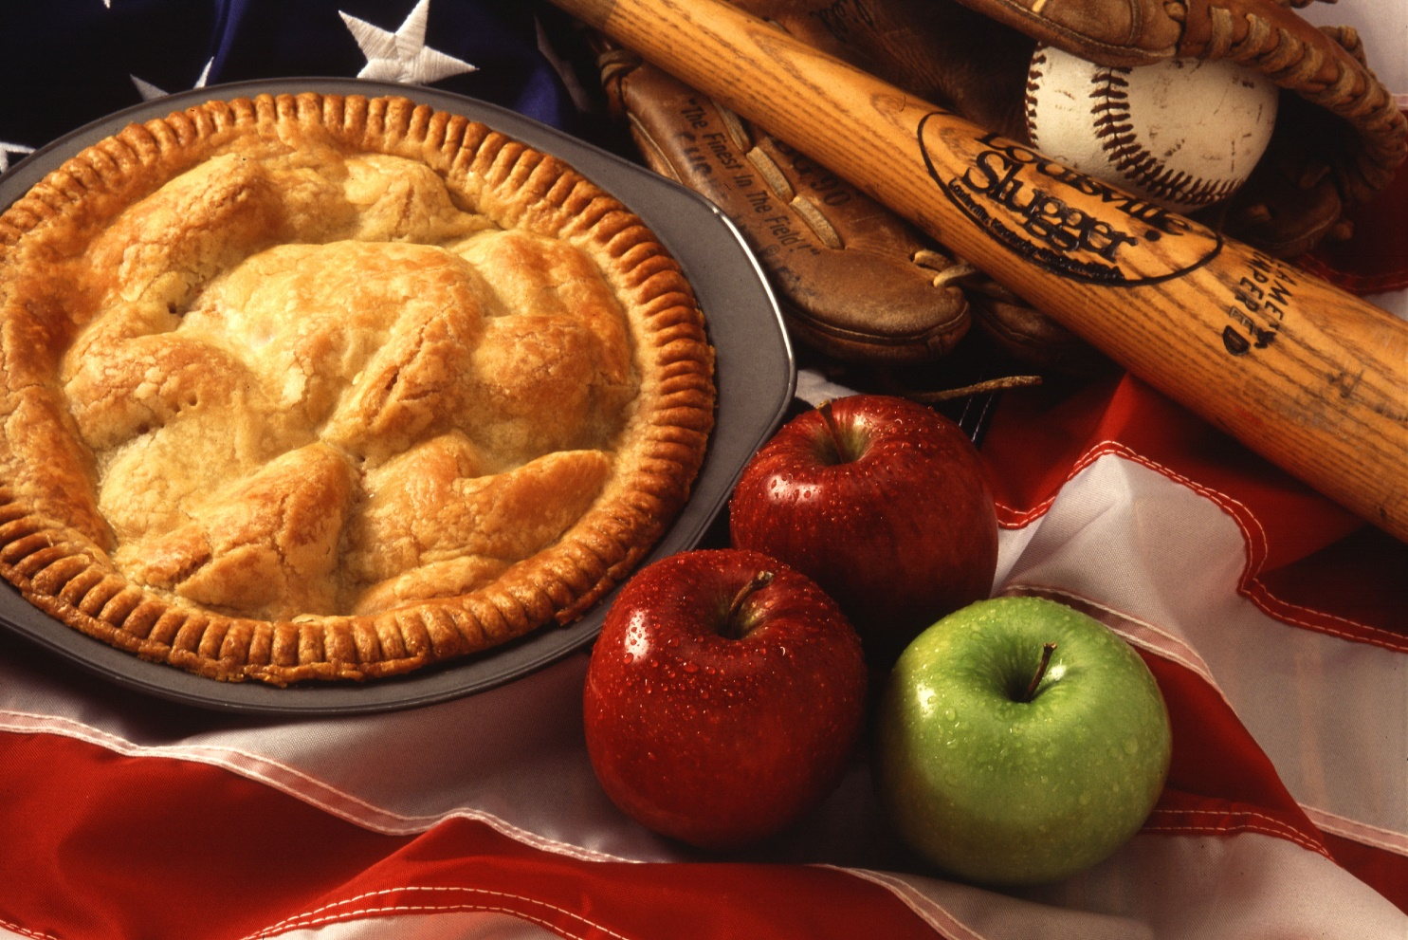
Earth – Geo and other subjects
Past environments and politics
Society and Culture
Economics

Slide 26
Earth – Geo as a career
Government
Business
Education
Climate and Weather experts
Soil Scientists
Environmental studies
Proposed development projects on air, water, and wildlife
Environmental impact coordinator
Health care
Transportation
Population studies
Economic development
International Economics
An so much more

