Slide 1
Russian Geography
A vast land of resources and geographical wonders.

Slide 2
Natural resources
Coal is the largest mineral found in the Siberian region of Russia.
Oil reserves as well as gas, are some other resources that can be found in Russia.

Slide 3
RUSSIAN climate AND geography
Russia only has two primary seasons
Winter and Summer
The Northern Regions have more arctic temps while the southern regions have Deserts
Spring and Autumn are brief in Russia
The winters are sure to bring lots of snow and ice but, it does not last forever
The winters range from 14 degrees to as cold as -15 degrees
The Summers get as warm as 77 degrees
The Harsh Russian winters have stopped many a military invader from succeeding.
What is the dominant feature in Russia?

Slide 4
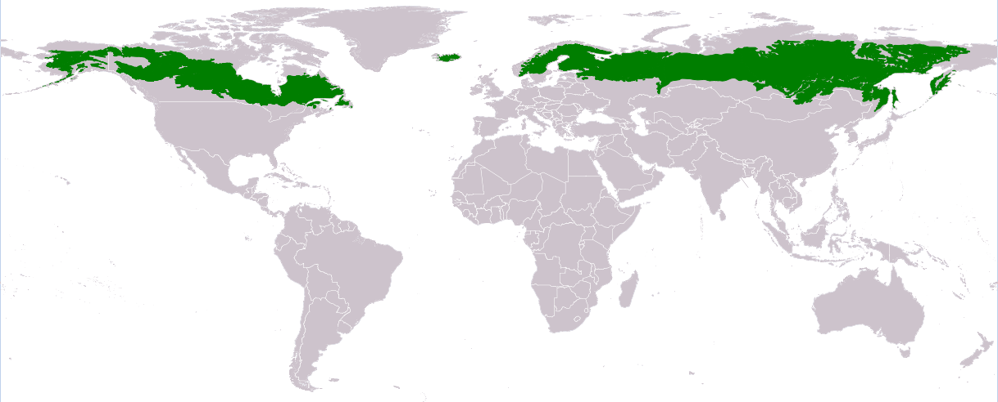
The Taiga Forest

Slide 5
Russian Features
The Taiga forest makes up 2/3 of the Country of Russia
Russia spans two countries Europe and Asia
The Ural Mountains is located between the Black Sea and the Caspian Sea
It also forms the boundary between European Russia and Asia Russia
The Volga River connects Moscow to the Caspian Sea, and acts as an important water way for Russian trade, travel, and the moving of resources more easily
Lakes are a key part of the Russian landscape as well. The most remote lake in Russia is Lake Baikal which is located in Siberia
Siberia which is a remote place that many Russian leaders have exiled enemies to over the centuries.
Finally it is important to note that 80% of Russia’s population are located along the Northern European Plain.

Slide 6
Northern European Plain

Slide 7
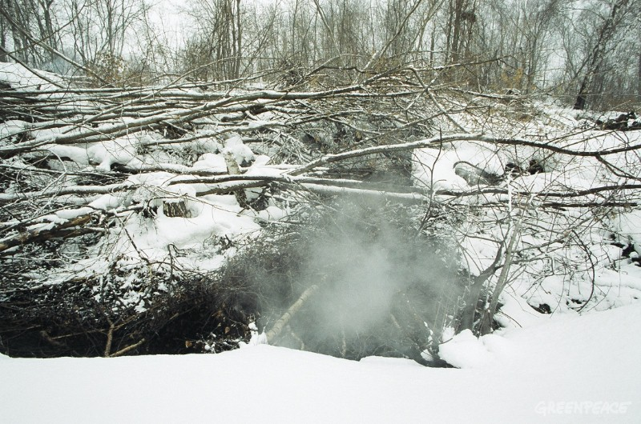
Geographical concerns
What is the biggest geographical disaster in Russian history?
Chernobyl – A nuclear facility that exploded and fire released large quantities of radioactive particles into the atmosphere, which spread over much of the western USSR and Europe.
Global freezing…Global warming….rather Climate change experts fear that if the thawing of the world’s largest peat bogs – (Marshes or swamps) could release billions of tons of Methane into the atmosphere causing a similar disaster to that of Chernobyl.

Slide 8
Homework for 10/5/2015
Fill out the Blank Russian map on your desk and be sure to color in the section showing the massive Taiga Forest.
Also be sure to draw in the Ural Mountains in both the European Russia area as well as the Asian
Finally write a two paragraph summary Russian geography and what you learned.

