Slide 1
United States Economics
King of Capitalism

Slide 2
U.S. Economics
Economics
A. U.S. and Canada differ Economically
1. U.S. uses most of it’s land for commercial farming. Canada uses most of it’s land for hunting and gathering.
B. U.S. Farming has changed over the years
1. At the beginning of the 21st Century 41% of the U.S. was engaged in farming.
2. By 2005 this changed
a) The reason the nation’s economy diversified after improvements in transportation and communication.
C. The U.S. is what we call a market economy
1. This allows for business to profit, own, and operate their own business.
D. Technology
1. Widely considered the main thing that transformed the workplace in the U.S. and Canada in the post Industrial Economy

Slide 3
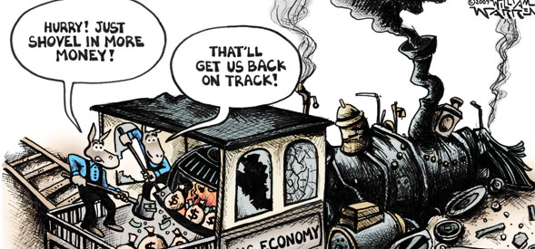
U.S. Economics
II. Economic Facts
A. Cities use retooling to convert old industries into new factories and other buildings
B. Monopoly – Total control of a type of industry by one person or one company
C. Developed country produces and sells agricultural commodities, or goods.

Slide 4
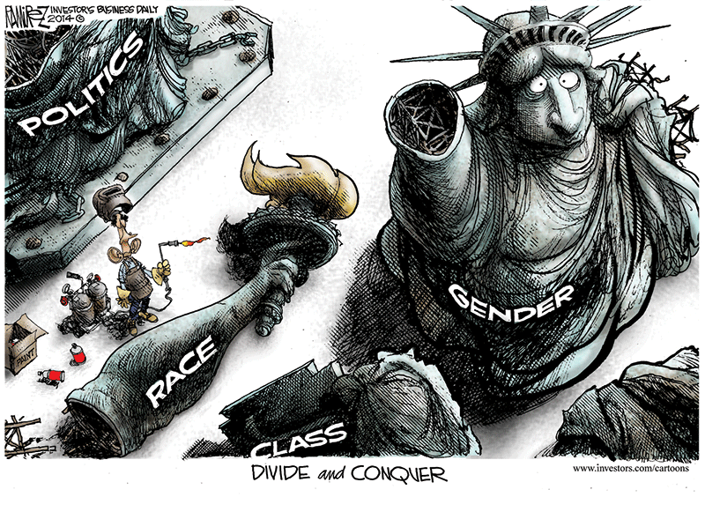
U.S. Economics
III. Business life in America
A. What makes big business so successful in the U.S.
1. Treatment of it’s employees
2. Products people want and demand meets supply.
3. Management listens to it’s lower level employees, and it’s upper level management.
B. Entrepreneurship in America
1. Small business make up 78% of the countries companies.
2. Most business owners are in debt and broke for the first 5 years of the business.
3. 61% of Small business owners are not considered middle class.
4. Government regulations have crippled small business abilities to do business.
5. The most affected group in the U.S. when bills, laws, and regulations are passed. Also most affected by economic downfalls and crashes.

