Slide 1
U.S. Government
The Constitution and the electoral college

Slide 2
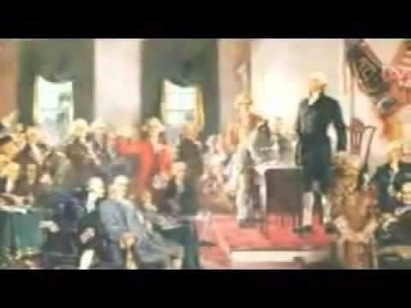
U.s. Government
The difference between the right and left.

Slide 3
U. S. Government
I. The Constitution and what it means
A. The six Principles of the Constitution
1. Popular Sovereignty – The purpose of government is to protect its people. The power of the government lies with the people
2. Limited Government – Government does not gain power through itself, it can only use the power the people give it through laws.
3. Separation of Power – Each branch has its own purpose. That purpose keeps it in a powerful position and makes each branch relevant.
4. Checks and balances – Each branch has several checks in place to ensure one branch does not become too powerful.
5. Marbury v. Madison 1803 – Allows the Supreme Court to determine whether acts and laws are unconstitutional.
6. Federalism – gives states powers that keep it from the total control of the federal government. Some powers do overlap.

Slide 4
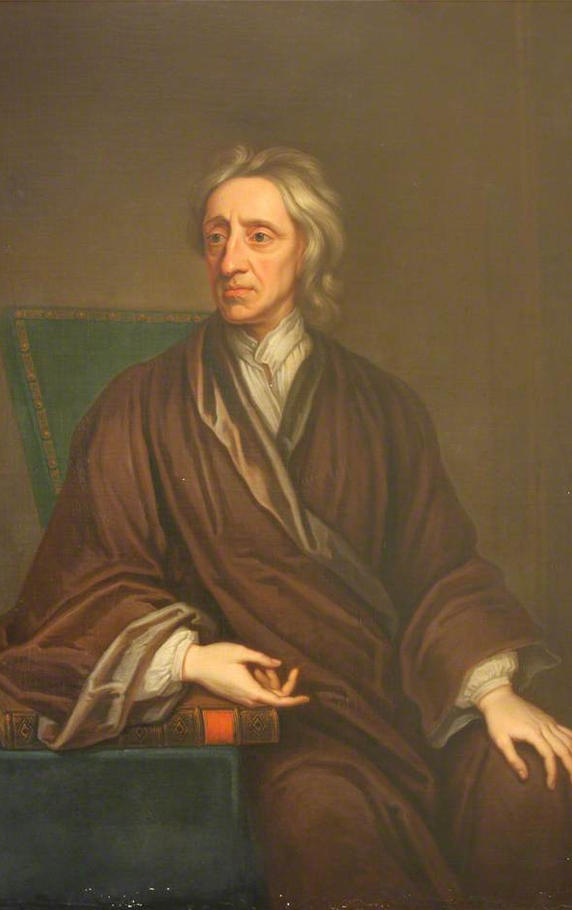
U. S. Government
II. The constitution and what it means
B. Philosophers behind the constitution
1. Plato – Government should create good
2. Aristotle – Idea of the common interest
3. Machiavelli – Citizens act for the common good
4. Hobbs – Natural law believed in social contract
5. Locke – Government should be limited in its power
6. Montesquieu – Believed in separation of powers for gov.
7. Rousseau – Role of gov. was to ensure the common good or welfare of the people was protected.

Slide 5
U.S. Government
III. The amendments
A. 1st Amendment – Free speech
1. Does not grant one the right to not be offended
B. 2nd Amendment – right to bear arms
1. shall not be infringed!
C. 3rd Amendment – Quartering soldiers against one’s will
1. In times of peace the gov. can’t force someone to house soldiers.
D. 4th amendment – unlawful search and seizers
1. A warrant is needed to look into one’s belongings.
E. 5th Amendment – double jeopardy and the guarantee of due process
1. pleading the 5th to protect oneself from the law.
F. 6th amendment – Fair and speedy trial
7th Amendment – Right to a jury trial
1. Trial by one’s peers
G. 8th Amendment – forbids unreasonable bails and fines and punishment that is unusual or cruel
H. 9th Amendment – Rights not mentioned by the constitution are provided for the people.
I. 10th Amendment – Powers not given to the state and federal government are given to the people

Slide 6
U.s. Government
IV. Amendments
A. The remaining 17 amendments
1. 11th – States are protected from law suites by citizens in other states
2. 12th – Modified the procedures for electing the president and vice president
3. 13th – except for punishment of crime, involuntary slavery and or servitude is illegal
4. 14th – details equal protection, due process, citizenship clauses, and clauses dealing with
the confederacy
5. 15th – Suffrage rights regardless of race, color, or prior slave status
6. 16th – Reserves the governments right to tax income
7. 17th – establishes popular voting as to how a senator is selected
8. 18th – denies the sale of alcohol
9. 19th – Woman’s suffrage rights
10. 20th – “lame duck amendment” – Congress starts Jan 3rd, pres. Jan 20th.
11. 21st – repealed the 18th amendment
12. 22nd – limits the terms a president can have to 10 years max
13. 23rd – D.c. can vote for it’s own electors for president
14. 24th – Denial of a poll tax
15. 25th – establishes the process for a successor for president
16. 26th - 18 years old to vote
17. 27th – denies any laws that vary the salaries of congress members until the beginning of
next term of office for the representatives.

Slide 7
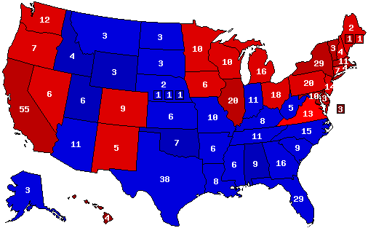
U.S. Electoral College Map

Slide 8
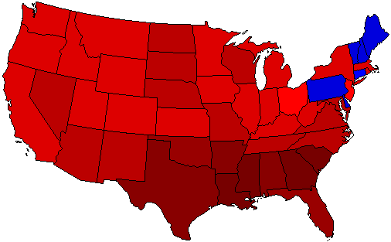
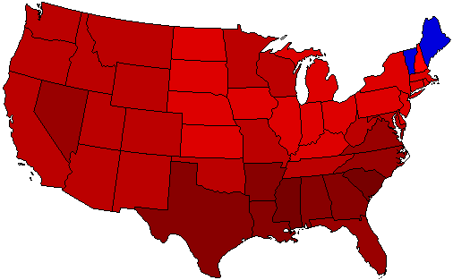
A Deeper look at what makes a great president
F.D.R. 1932
F.D.R. 1936

Slide 9
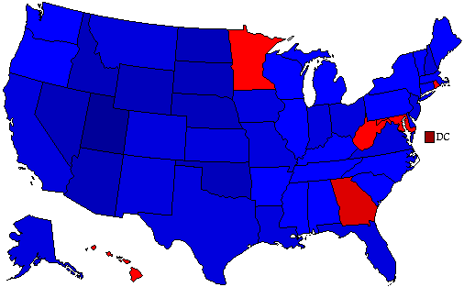
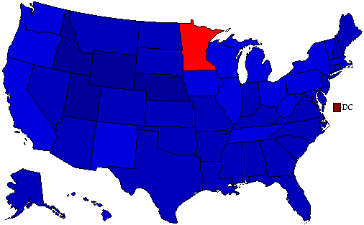
A Deeper look at what makes a great President
Reagan 1980
Reagan 1984

