Slide 1
U.S. and Canadian History
A bit of Geo and a bit of History

Slide 2
History I. U.S. and Canadian history A. In order to expand westward the U.S. needed land they did not own. 1. Thomas Jefferson brokers deals with the French to buy up large chunks of land a) The man Thomas Jefferson dealt with – Napoleon Bonaparte B. The U.S. became a leader in industry by the late 1800’s 1. The Midwest became a leading center of Industry in the U.S. by 1800’s a) Large supplies of coal made steam power cheap. C. Canada invades the U.S. 1. More accurately the Brits who owned Canada attack the U.S. a) The Capital is attacked and burned to the ground. b) War of 1812 is eventually won by the U.S. 2. Shows that the U.S. and Canada played a role in each others histories
Geography
States with high elevation are the Rocky Mtns. – Arizona, Colorado, New Mexico, Utah, Nevada, Wyoming, Idaho, and Montana
Appellations Mountain States - Alabama, Georgia, South and North Carolina – (NC has the highest altitude of any of the Appellation states), Tennessee, Kentucky, Virginia, Maryland, Philly, New York, Mass, Vermont, New Hampshire, and Maine
The two Mountain ranges are the only real major mountains in North America
Lake Erie forms part of the Northern boarder of Ohio.

Slide 3
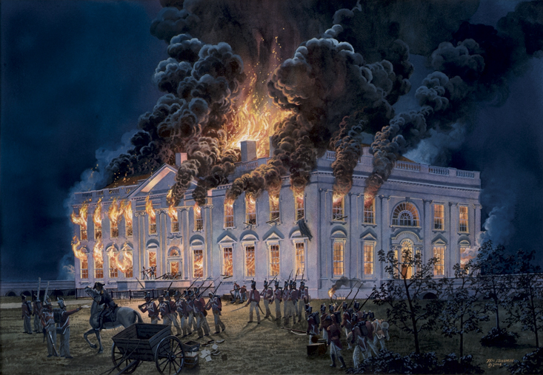
The Capital is sacked in the War of 1812

Slide 4
U.S. History Continued
Immigration
Most people of the U.S. are immigrants of descendants of immigrants
Over the years a deeper look at immigration laws
From 1830 – 1890: Italians, Irish, British, Jewish people, and Greeks
From 1890-1910: Asian, Jewish People, and Middle Eastern
From 1911-1930: French, and Jewish People
From 1931-1945: Jewish People and Asian
From 1946-1975: Germans, Russians, Mexicans, and Ukraine
From 1975 – 1996: Most Immigration laws became almost non existent.
From 1996 – 2001: Most Immigration laws were removed the addition of Sanctuary cities
From 2001 – Present: There are less restrictions on immigration today than there ever has been in the history of the U.S.

Slide 5
U.S. and Canadian history part II
Facts you may not know
About 1/3 of the U.S. Population is Not White
The Northeast most dominant characteristics is Megalopolis
The Canadian GOV. is called a Constitutional Monarchy
The U.S. is responsible for the French Revolution
Texas is the only state that could without penalty secede from the United States. It is called the Independent State of Texas for a reason.
The U.S. is the only country in the world to give aid, and to leave soldiers to help rebuild an enemy country
We are widely considered the reason WWI and WWII was won by our side.
As our Economy goes the World’s Economy goes.
We are the first country to allow blacks to compete in the Olympics outside of African countries obviously

Slide 6
A look at U.S. History

